Slide 1
2019 & 2020 AGMs
Introductions
Directors’ Report
2019 Events
2020 Events
Communications
Developments
Treasurer’s Report
2019 General Financial Statement
2019 Gazebo Financial Statement
2020 General Financial Statement
2021 Budget
Elections
Discussion

Slide 2
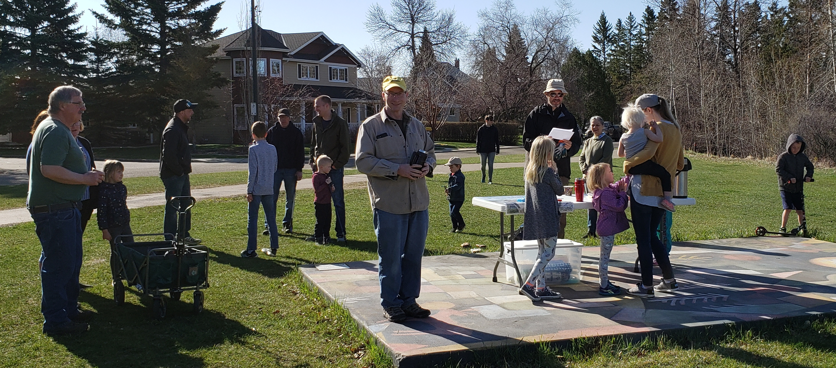
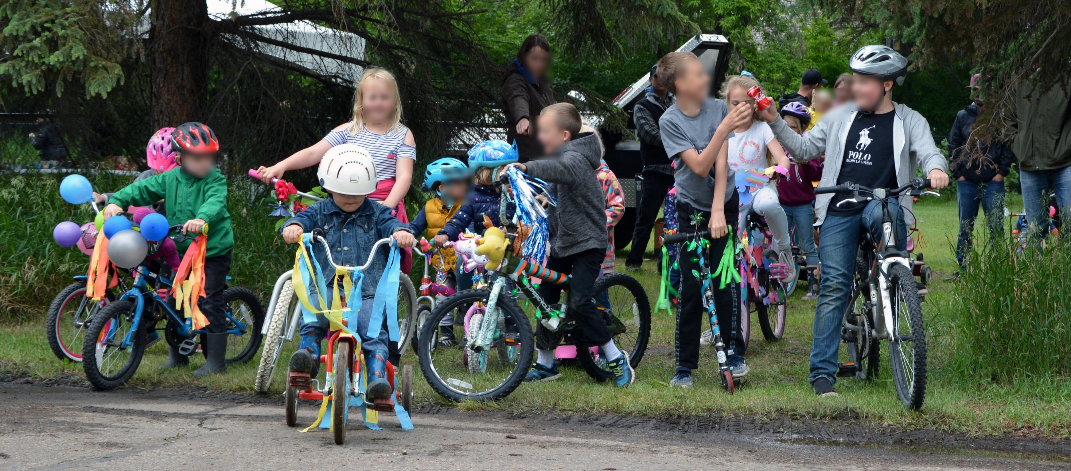
DIRECTORS’ REPORT
2019 EVENTS
March: Winter Games Wrap-Up
and 2018 AGM
May: Green Deer
June: BBQ & Bike Parade
July: Pop-Up Spray Park
with City of Red Deer

Slide 3
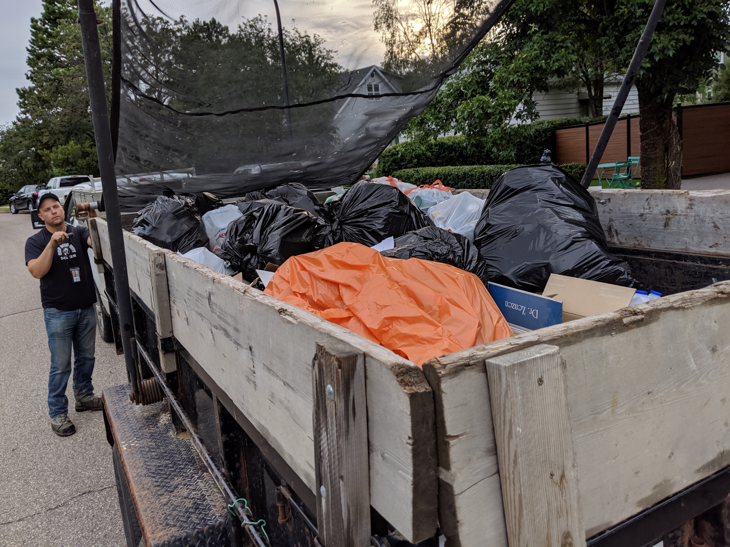
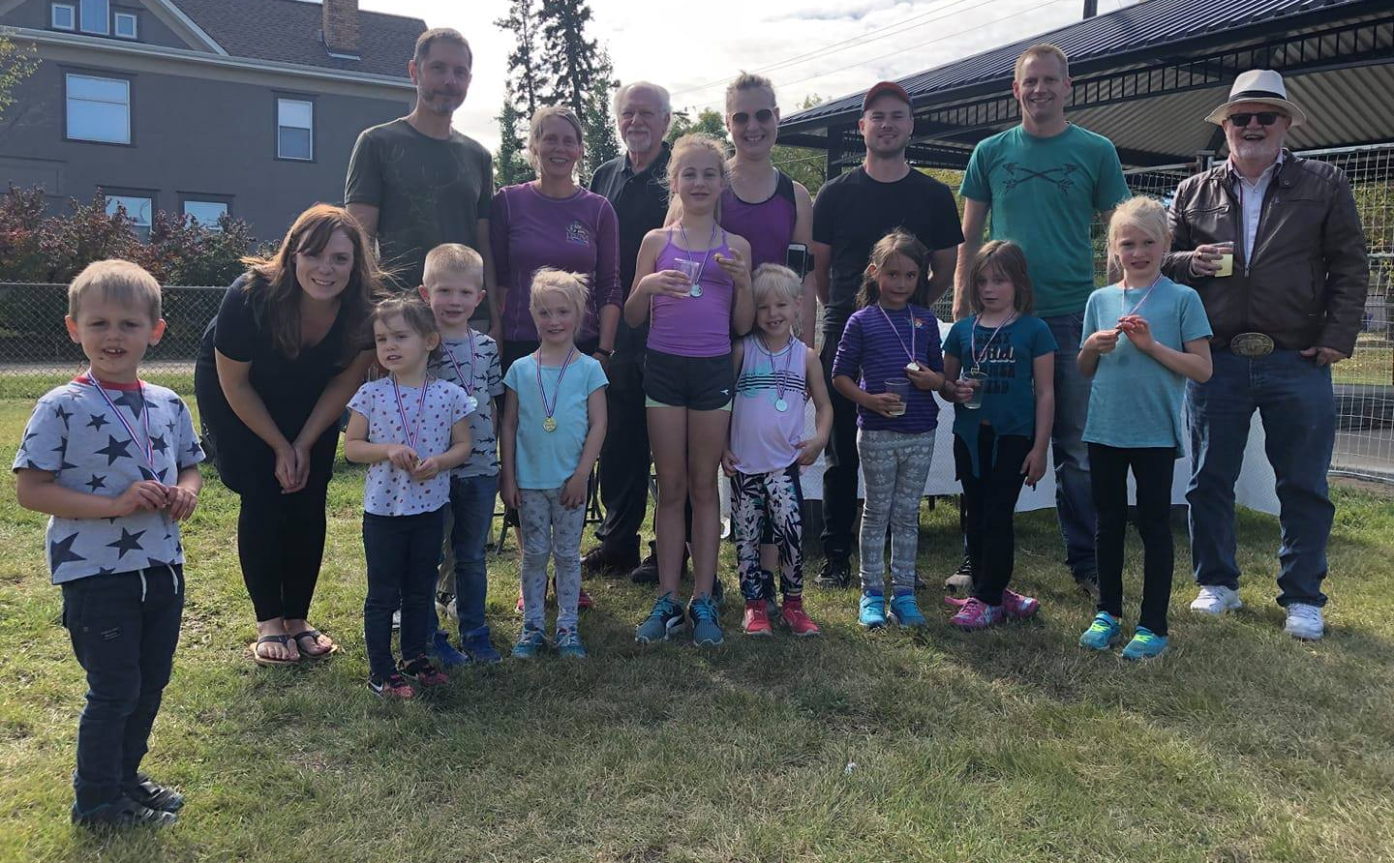
August: First Bottle Drive for the Playground
September: Movie Night in the Park
October: Fun Run & Online
Auction for the Playground

Slide 4
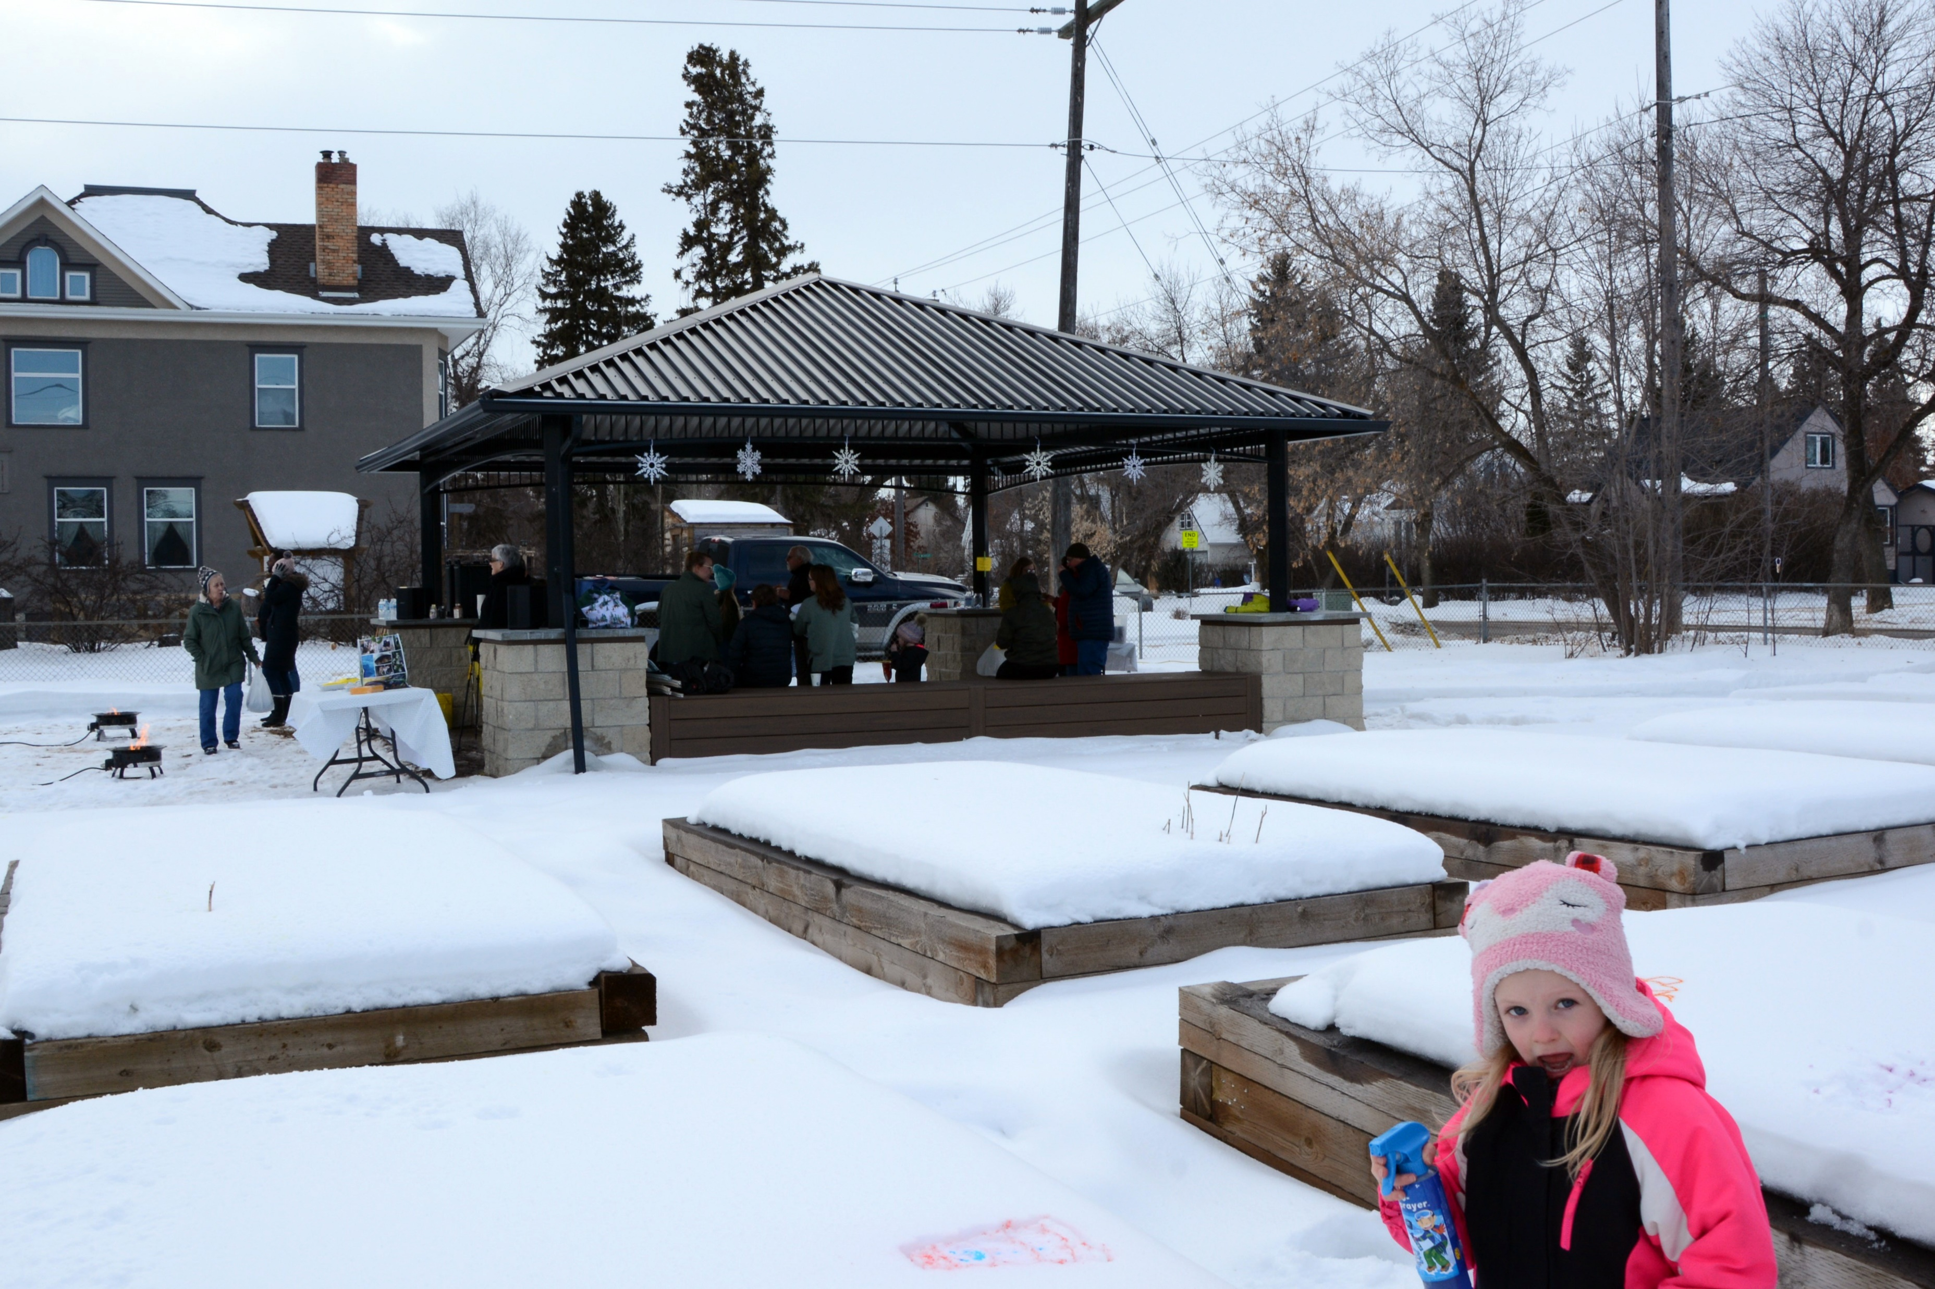
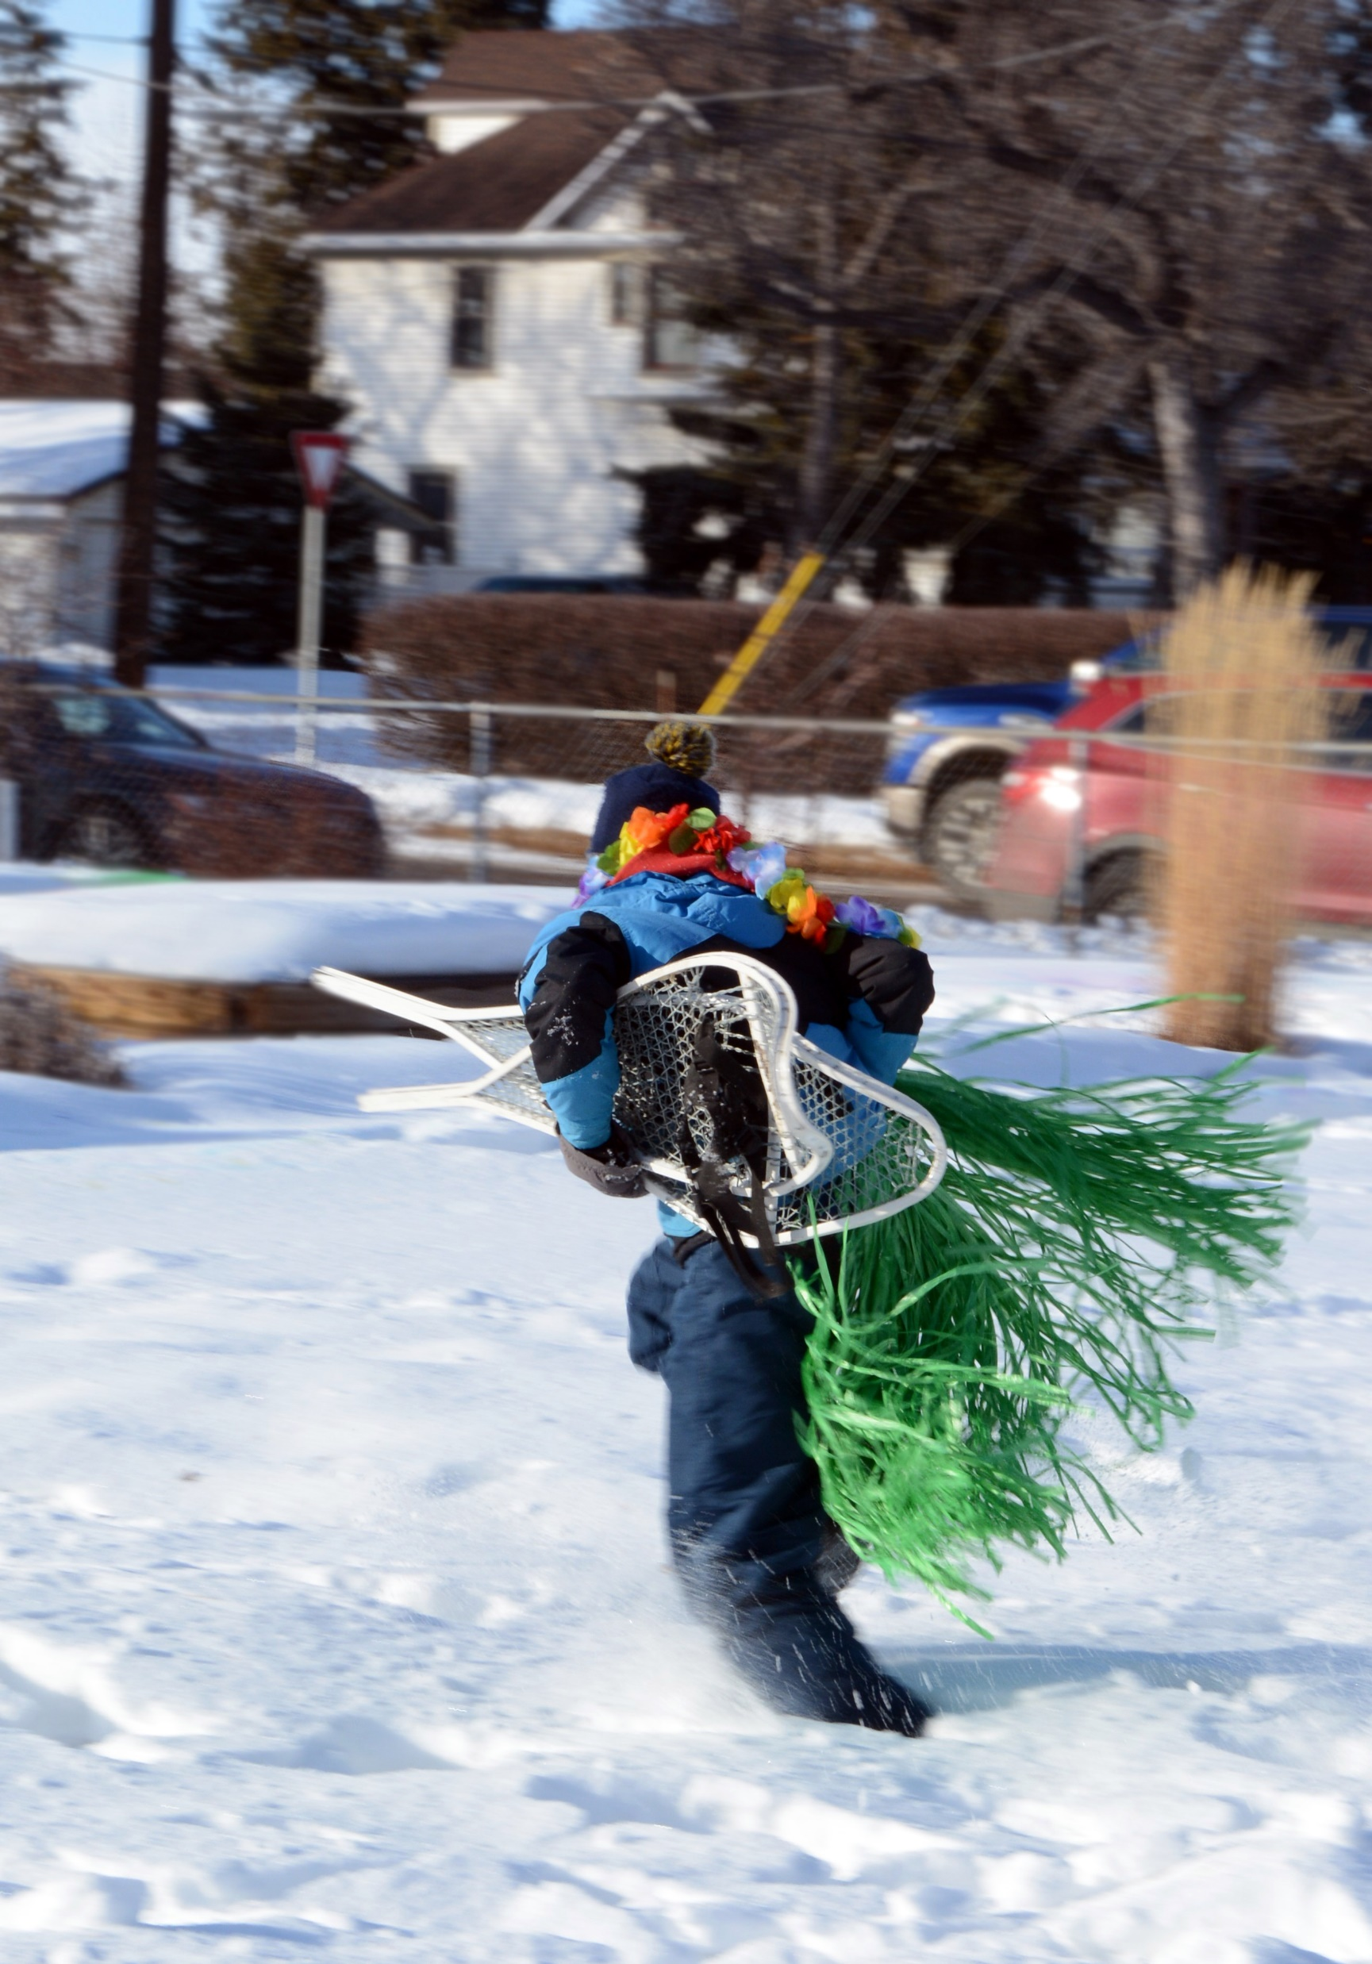
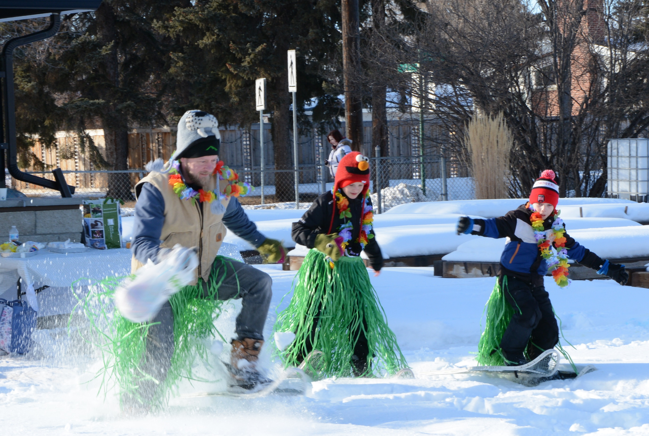
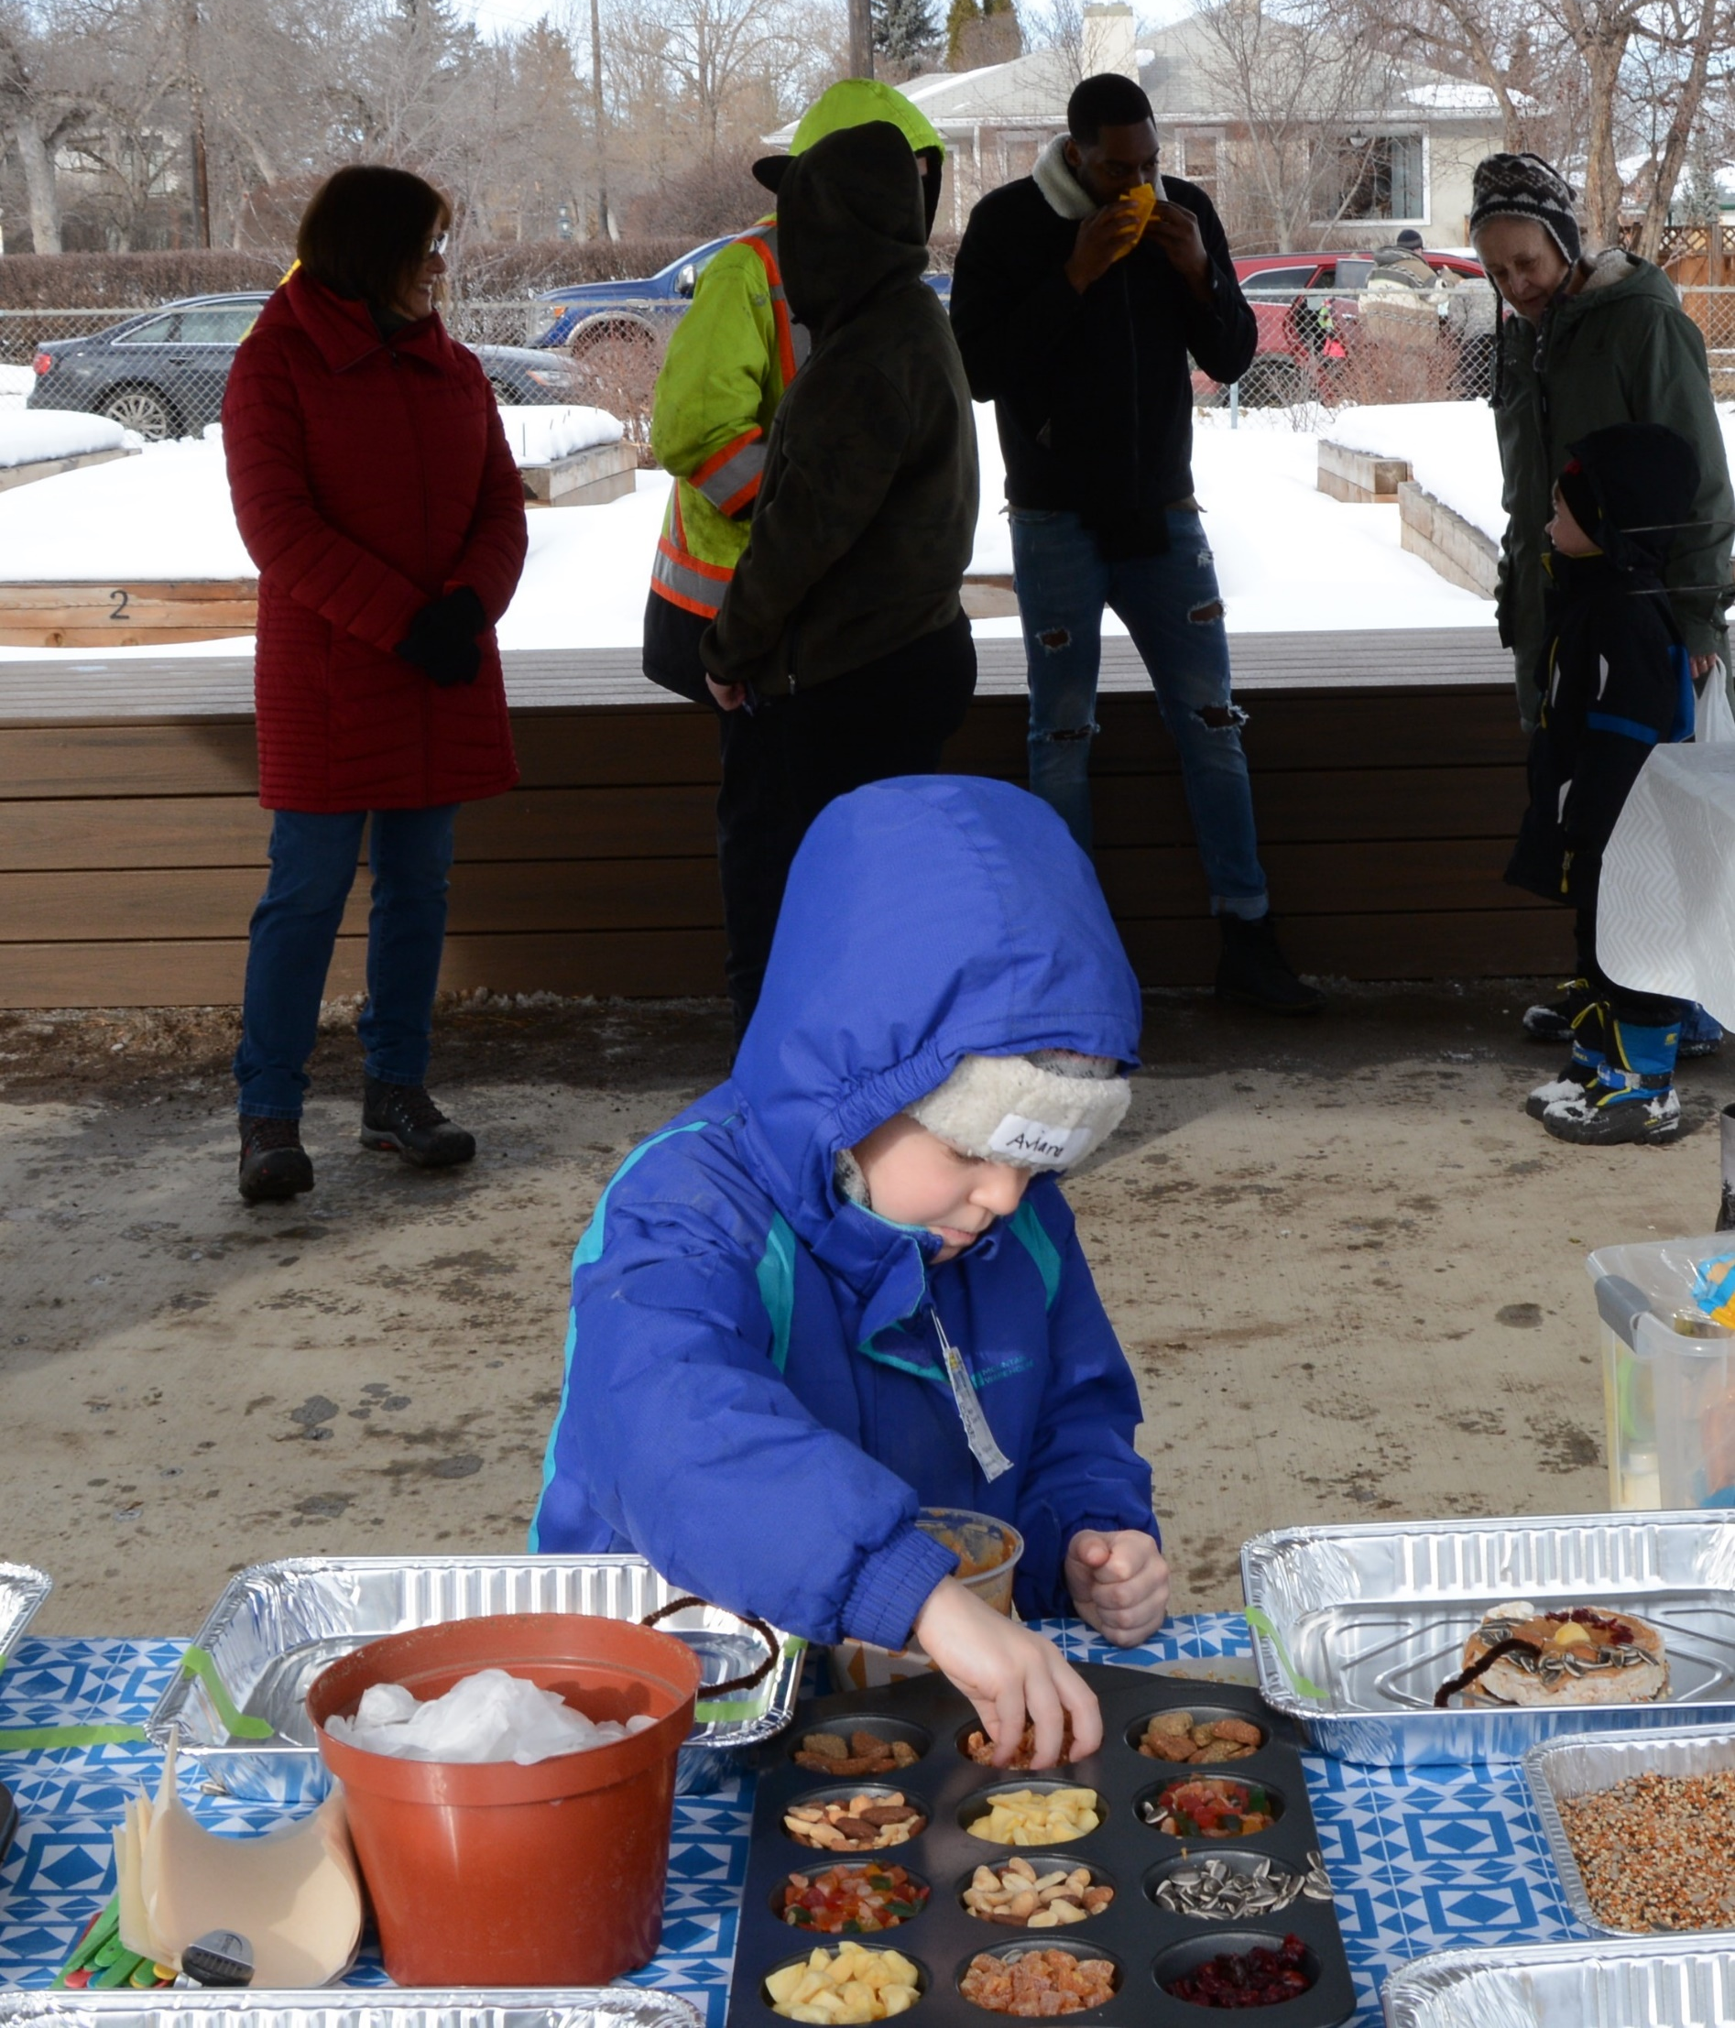
2020 EVENTS
February: Winter Fest and Chili Cook Off
March: AGM Cancelled

Slide 5
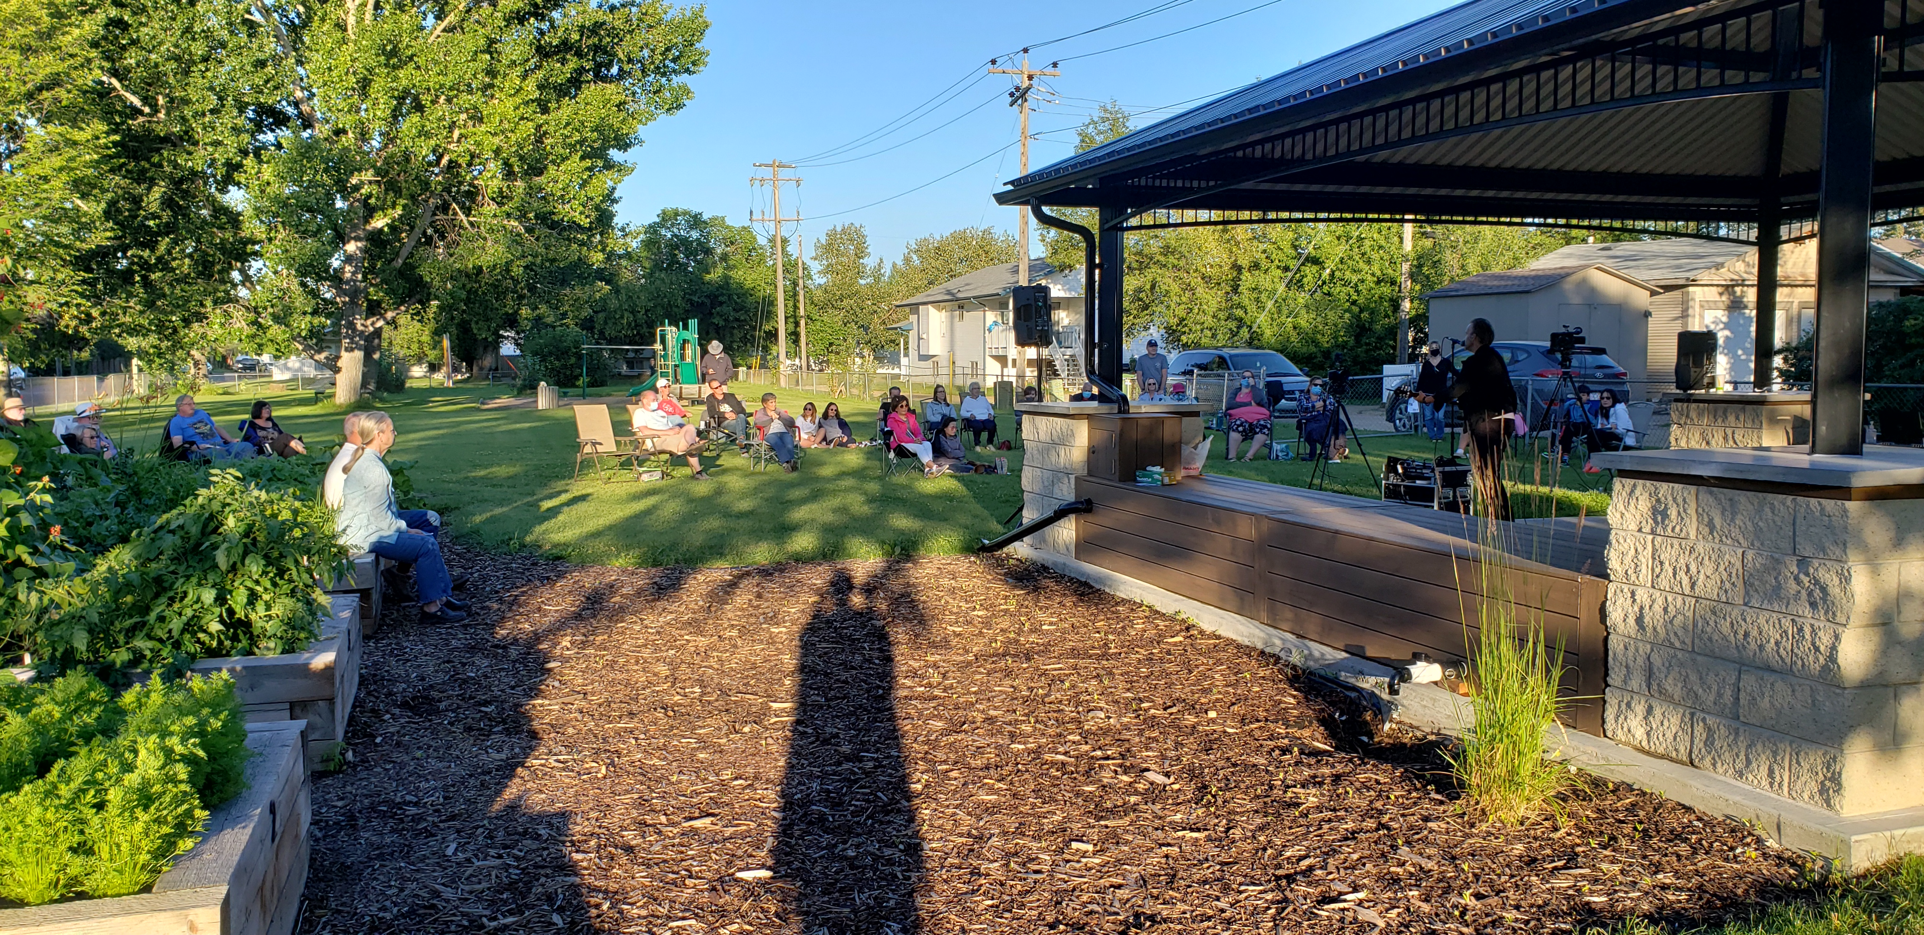
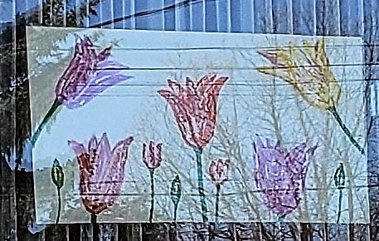
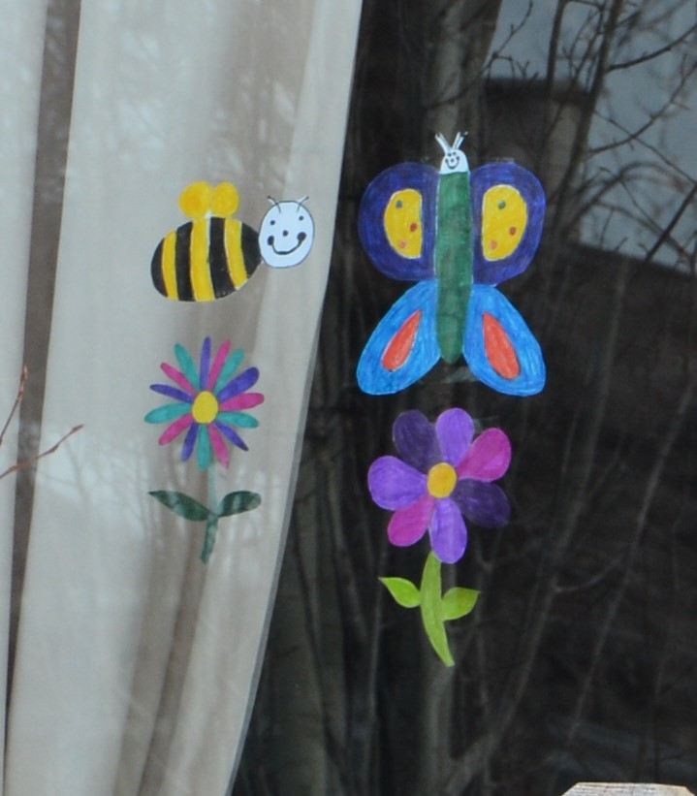
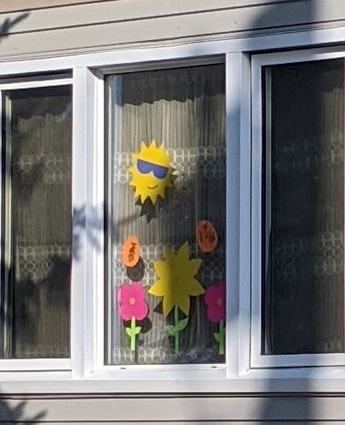
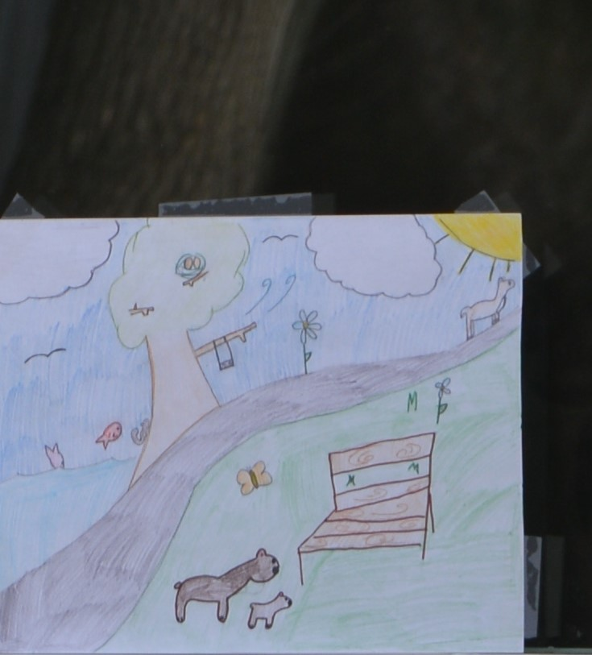
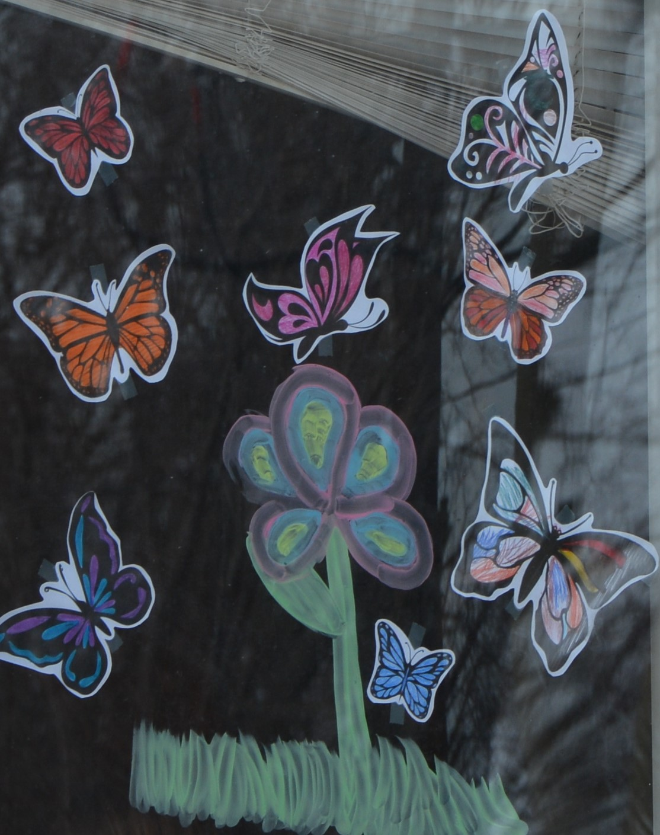
August: “In the Neighbourhood” Concert
with Red Deer Arts Council
March-April: Weekly Window
Decorating Themes
May: Green Deer Online Sign Up
& Veseys Fundraiser

Slide 6
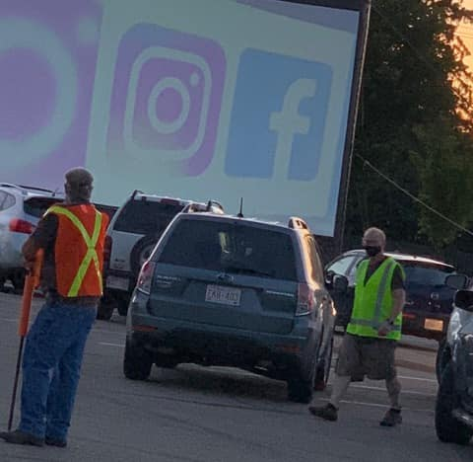
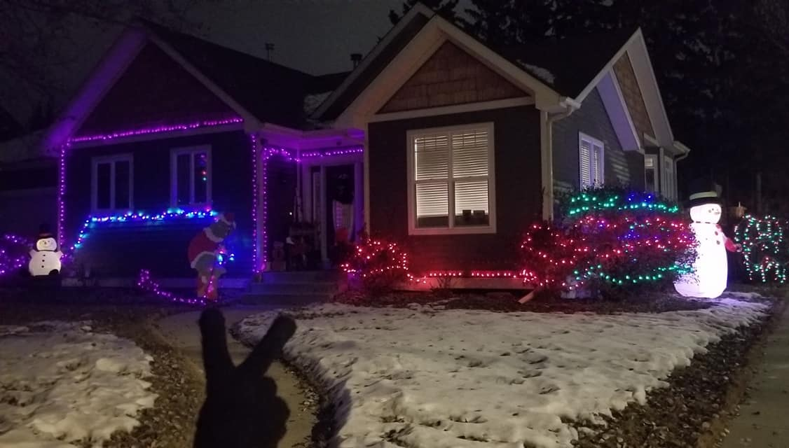
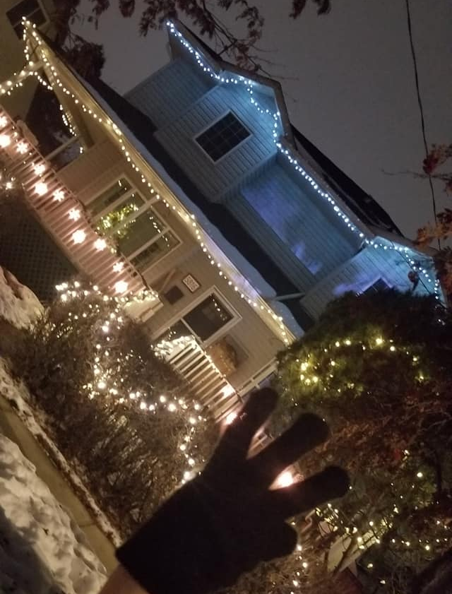
August: Drive-In Movie Night with
Fresh Aire Cinemas
City of Red Deer
Shunda
December: Deck the Halls Y’All &
First Ever Holiday Lights Contest
with City of Red Deer

Slide 7
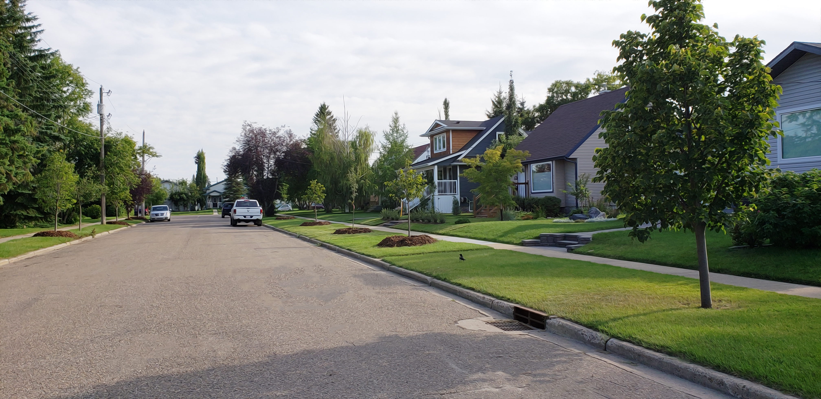
COMMUNICATIONS
313 Follows on @WaskasooCommunity Facebook Page
151 Members in Waskasoo Neighbourhood Watch Facebook Group
78 Members of the Waskasoo E-mail List
Letter to the Co-Op regarding the store closure. Followed with a meeting.
Met with Armouries personnel
Represented at CORD Community Association Meetings
Facilitated COVID-19 Offering and Getting Help email list
Gazebo and Drive In Movie Questions
Met with Planning Re: PS Land Zoning

Slide 8
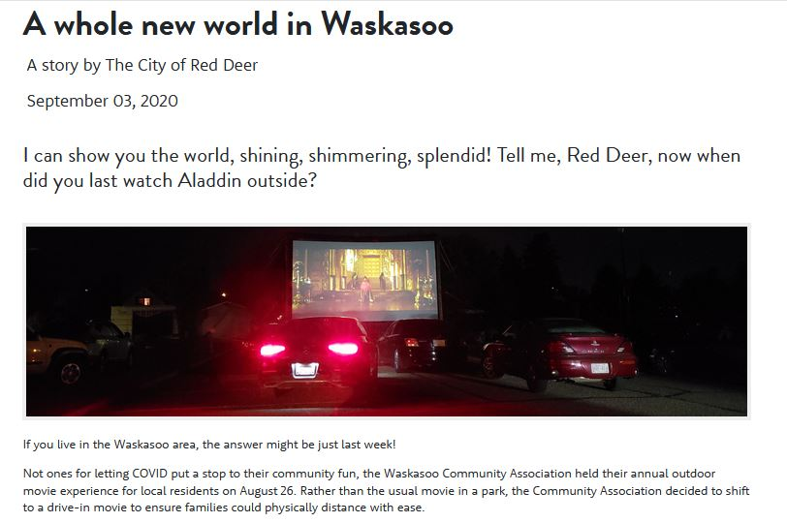
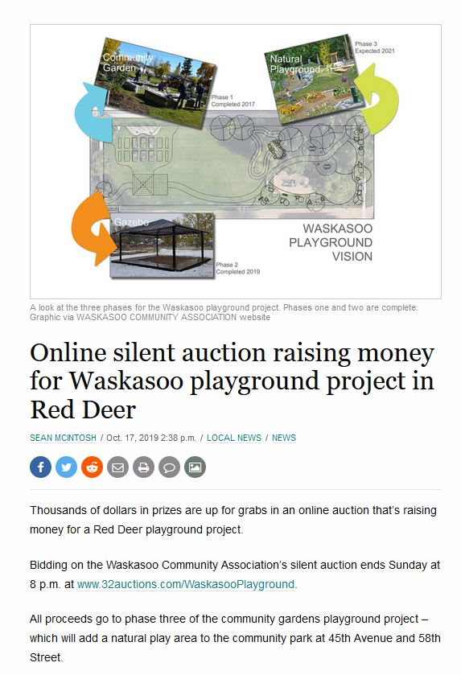
In the News

Slide 9
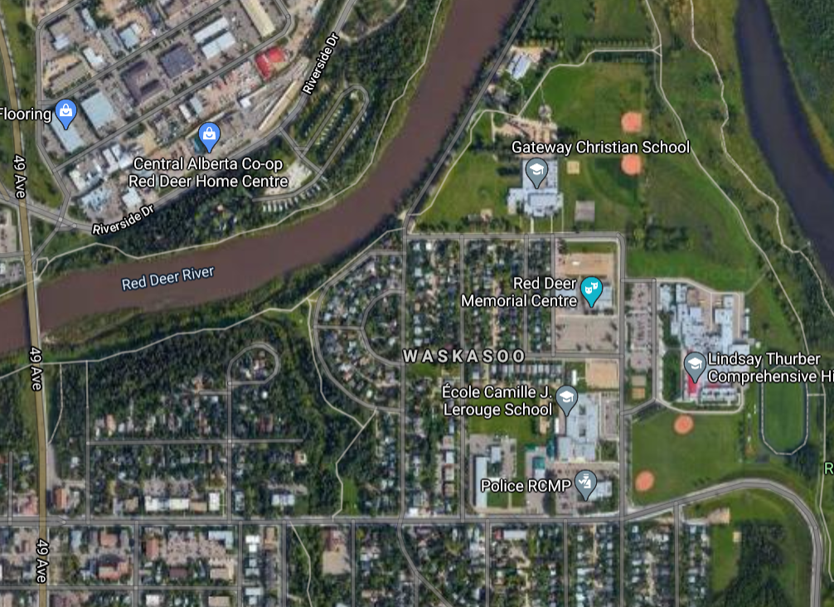
DEVELOPMENTS
Parkland CLASS Property
Chinooks Edge Property
4419 55 St.
5708 47A Ave
A
B
D
Shapes for possible developments
are NOT TO SCALE and lot lines
are ESTIMATED
C

Slide 10
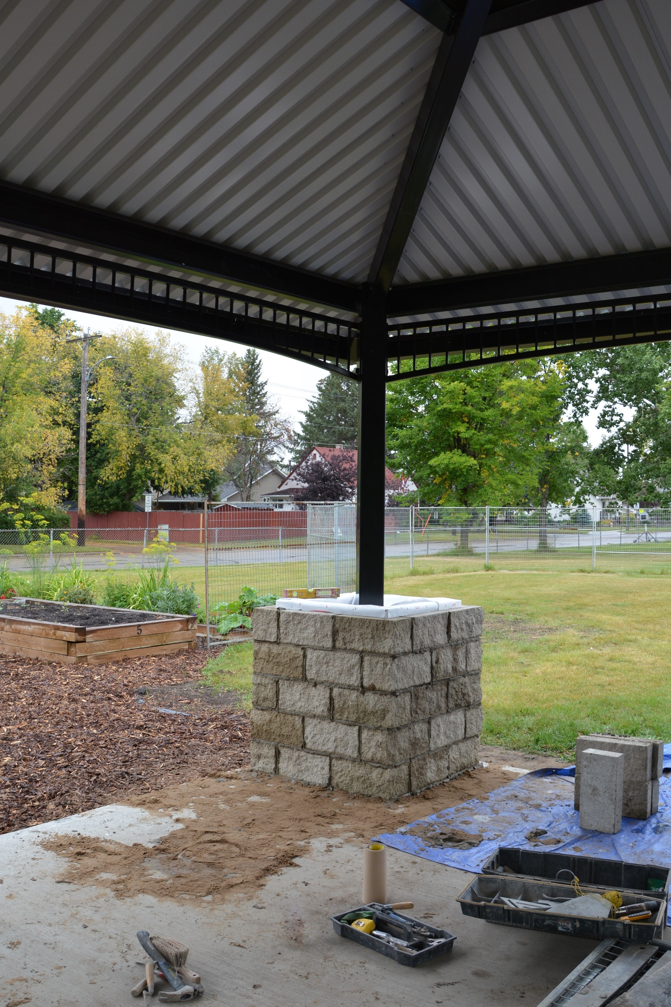
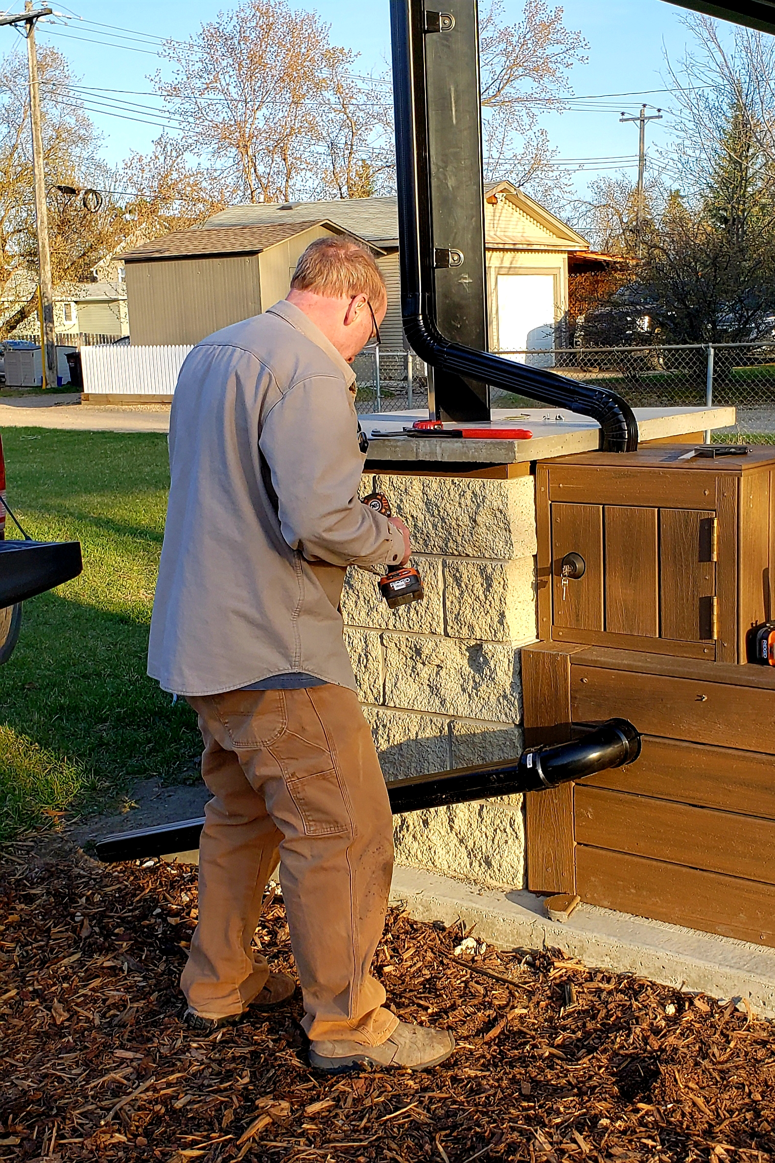
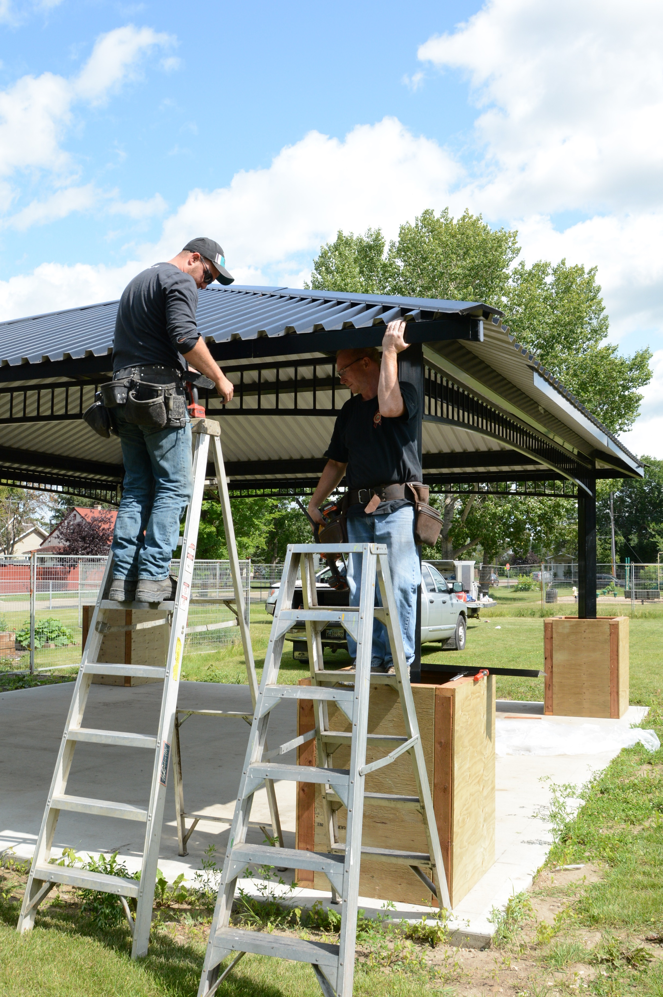
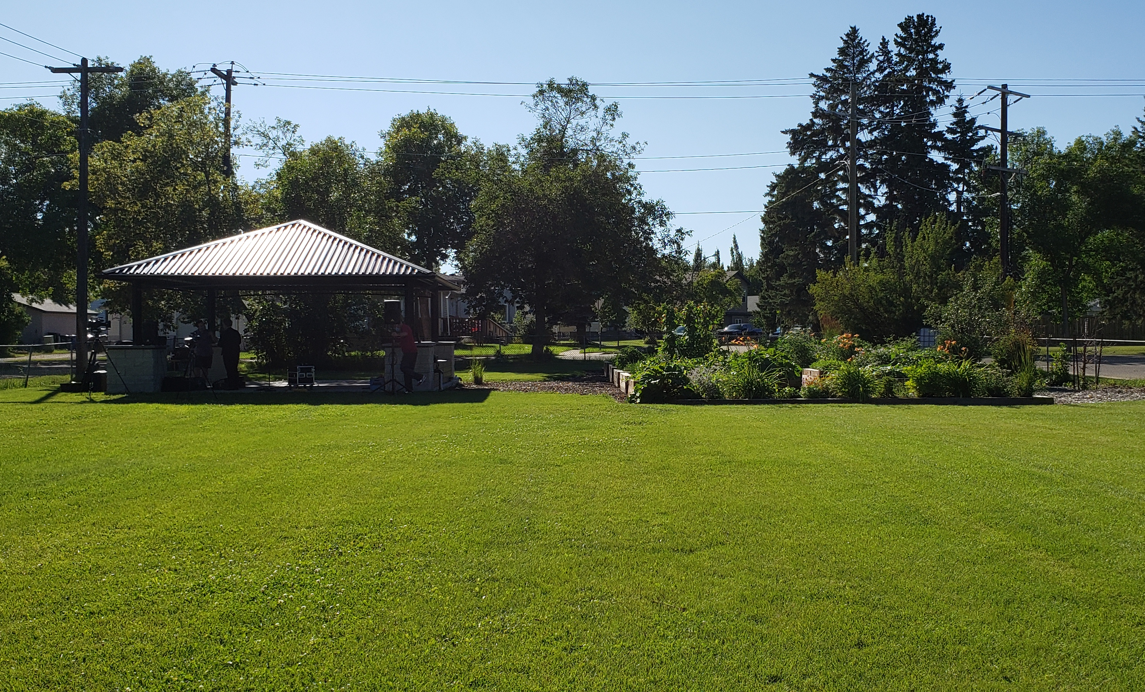
Waskasoo Gazebo Project
Officially Completed November 2019
Eavestroughs
Stone Columns
Water Tank
338 Volunteer Hours Logged
$40,600 in In-Kind Donations
($39,000 of those from Shunda)
$55,500 in Cash Costs
($51,500 from CFEP Alberta Grant)
$103,300 Total Cost
$120,000 Evaluation
Setting up for the Concert in the Park

Slide 11
Waskasoo Natural Playground
2019
Finishing Gazebo
Playground Subcommittee
Landscape Plan for Park

Slide 12
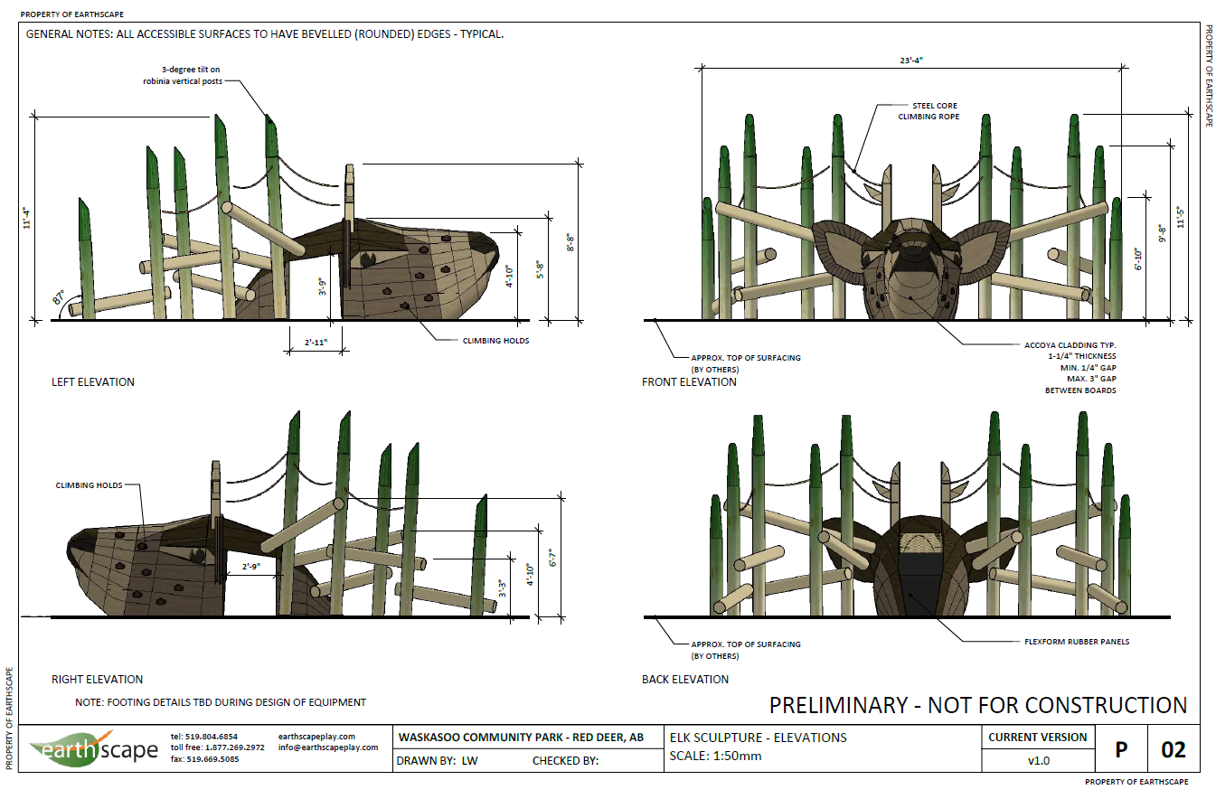
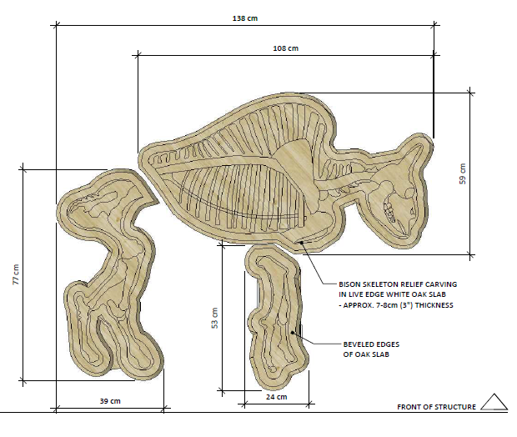
2020
Equipment Designs
Fundraising
City Approval

Slide 13
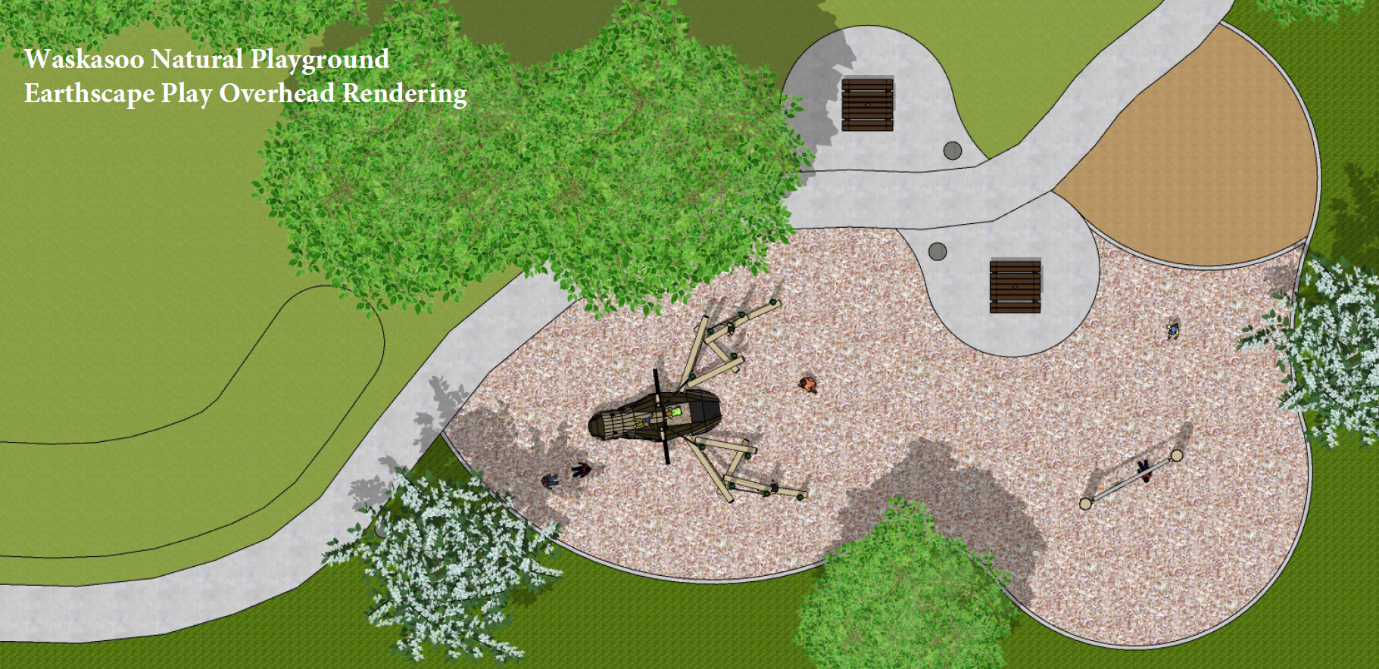

Slide 14
2021 Approval from Parks, specs from Earthscapes
Applied for Canada Healthy Communities Initiative Grant
The numbers:
Cash Costs: $273,755
Machinery and Fees $65,210
Labour $21,860
Total Cost: $360, 825
Revenue:
CHCI Grant $249,990
WCA Cash on Hand $9700
In-Kind Machinery & Fees $65,210
In-Kind Labour $21,860
$346,760
Left to Raise (Auction, purchase a plant, another grant….) $14,065
If we get the grant, the playground
should be completed by October 23!

Slide 15
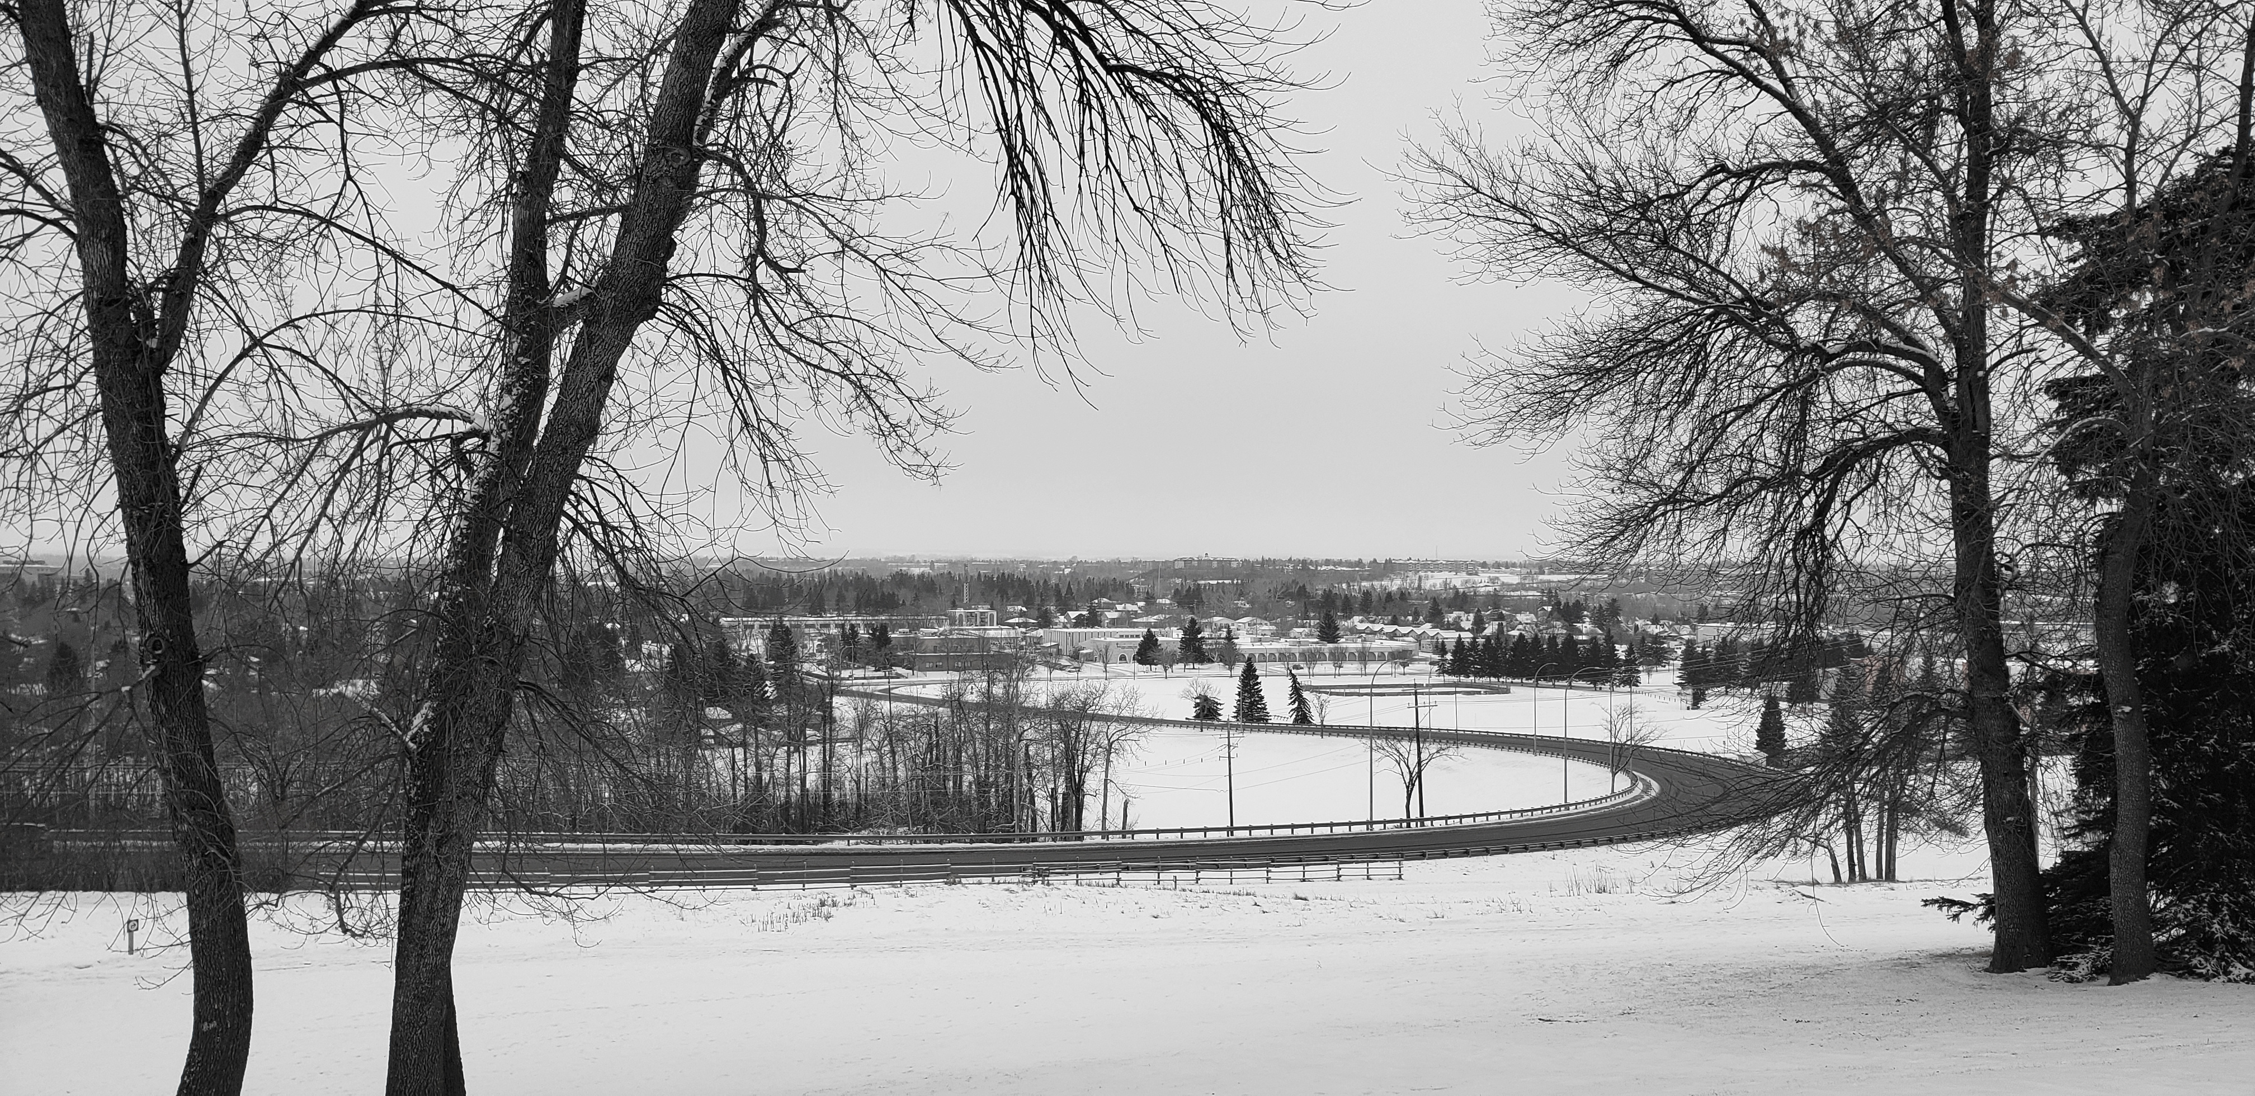
TREASURER’S REPORT
FINANCIAL STATEMENT: GENERAL ACCOUNT JANUARY 1 – DECEMBER 31, 2019
Opening Bank Balance Jan 1, 2019 $2274.94
INCOME:
Waskasoo Walking Tour Grant 2600.00
Canada Winter Games Wind-Up Grant 850.00
BBQ & Teddy Bear Picnic Grant 1000.00
CORD Operating Grant 2000.00
Memberships 640.00
Garden Plots 90.00
Bottle Drive 419.20
Fun Run 90.00
Movie Night Grant 1000.00
Playground Auction 5373.00
Gazebo Acct. Closure 2258.35
Playground Donations 487.50
TOTAL INCOME $16,808.05

Slide 16
TOTAL INCOME: $16,808.05
OPERATING EXPENSES
Waskasoo Walking Tour Booklet 2600.00
Annual General Meeting 163.43
Canada Winter Games Wind-Up 587.35
Green Deer 61.94
Fun Run Permit 25.00
BBQ 918.58
Bank Service Charges 79.89
Gardens 30.00
Gazebo Expense 232.50
Office Expense 7.96
Directors’ Liability Ins 765.00
Internet and Website 163.92
Movie Night in the Park 784.03
TOTAL EXPENSES $6419.60
CLOSING BALANCE Dec. 31, 2019 $12,663.39

Slide 17
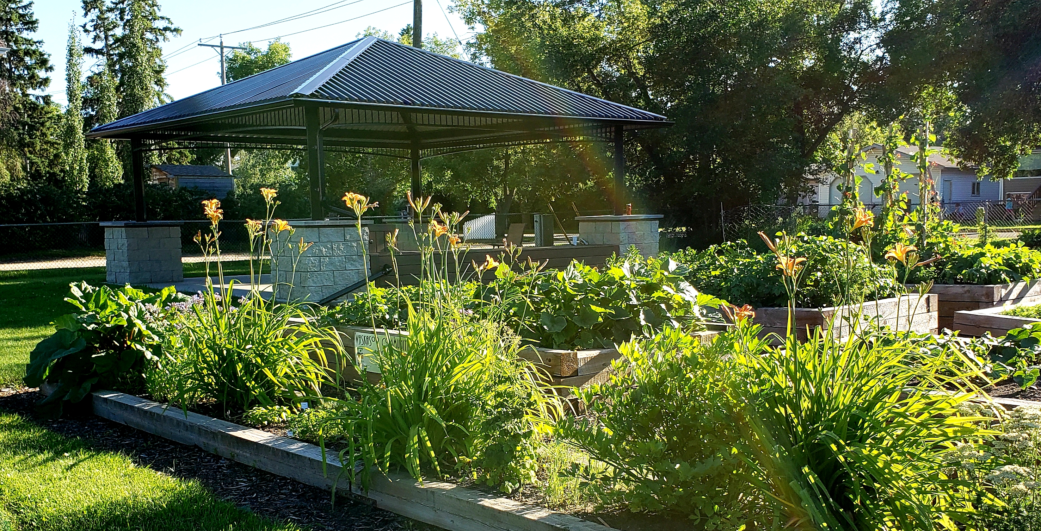
FINANCIAL STATEMENT: GAZEBO ACCOUNT JANUARY 1 – DECEMBER 31, 2019
Balance forward January 1, 2019 $11,577.16
Less Uncleared 2018 Cheque (330.04)
Subtotal: $11,247.12
Less
Bank charges 67.00
Steel 472.50
Water tank 1087.55
Delivery of tank (gas) 72.44
Weed barrier pegs 12.57
Marking paint 12.46
Roof edging (net) 35.28
Weed barrier 197.49
Powder coat steel 530.25
Wood 2092.70
Eaves trough 482.48
Concrete 641.67
Stone for pillars 3284.38
SUBTOTAL $8988.77
BALANCE: $2258.35
(Transferred to General Account Dec. 2, 2019)

Slide 18
FINANCIAL STATEMENT: GENERAL ACCOUNT JANUARY 1, 2020 – DECEMBER 31, 2020
Opening Balance, January 2, 2020: $12,663.39
Income:
Membership fees 310.00
Garden plot rentals 130.00
Donations nil
Winterfest grant 1,000.00
Drive In Movie Night grant 1,000.00
Operating grant 2,000.00
Playground cash donations 200.00
Playground bottle drive donations 712.26
Playground Vesey fundraiser 667.00
Total Income as per receipts $6019.26
TOTAL INCOME: $18,682.65

Slide 19
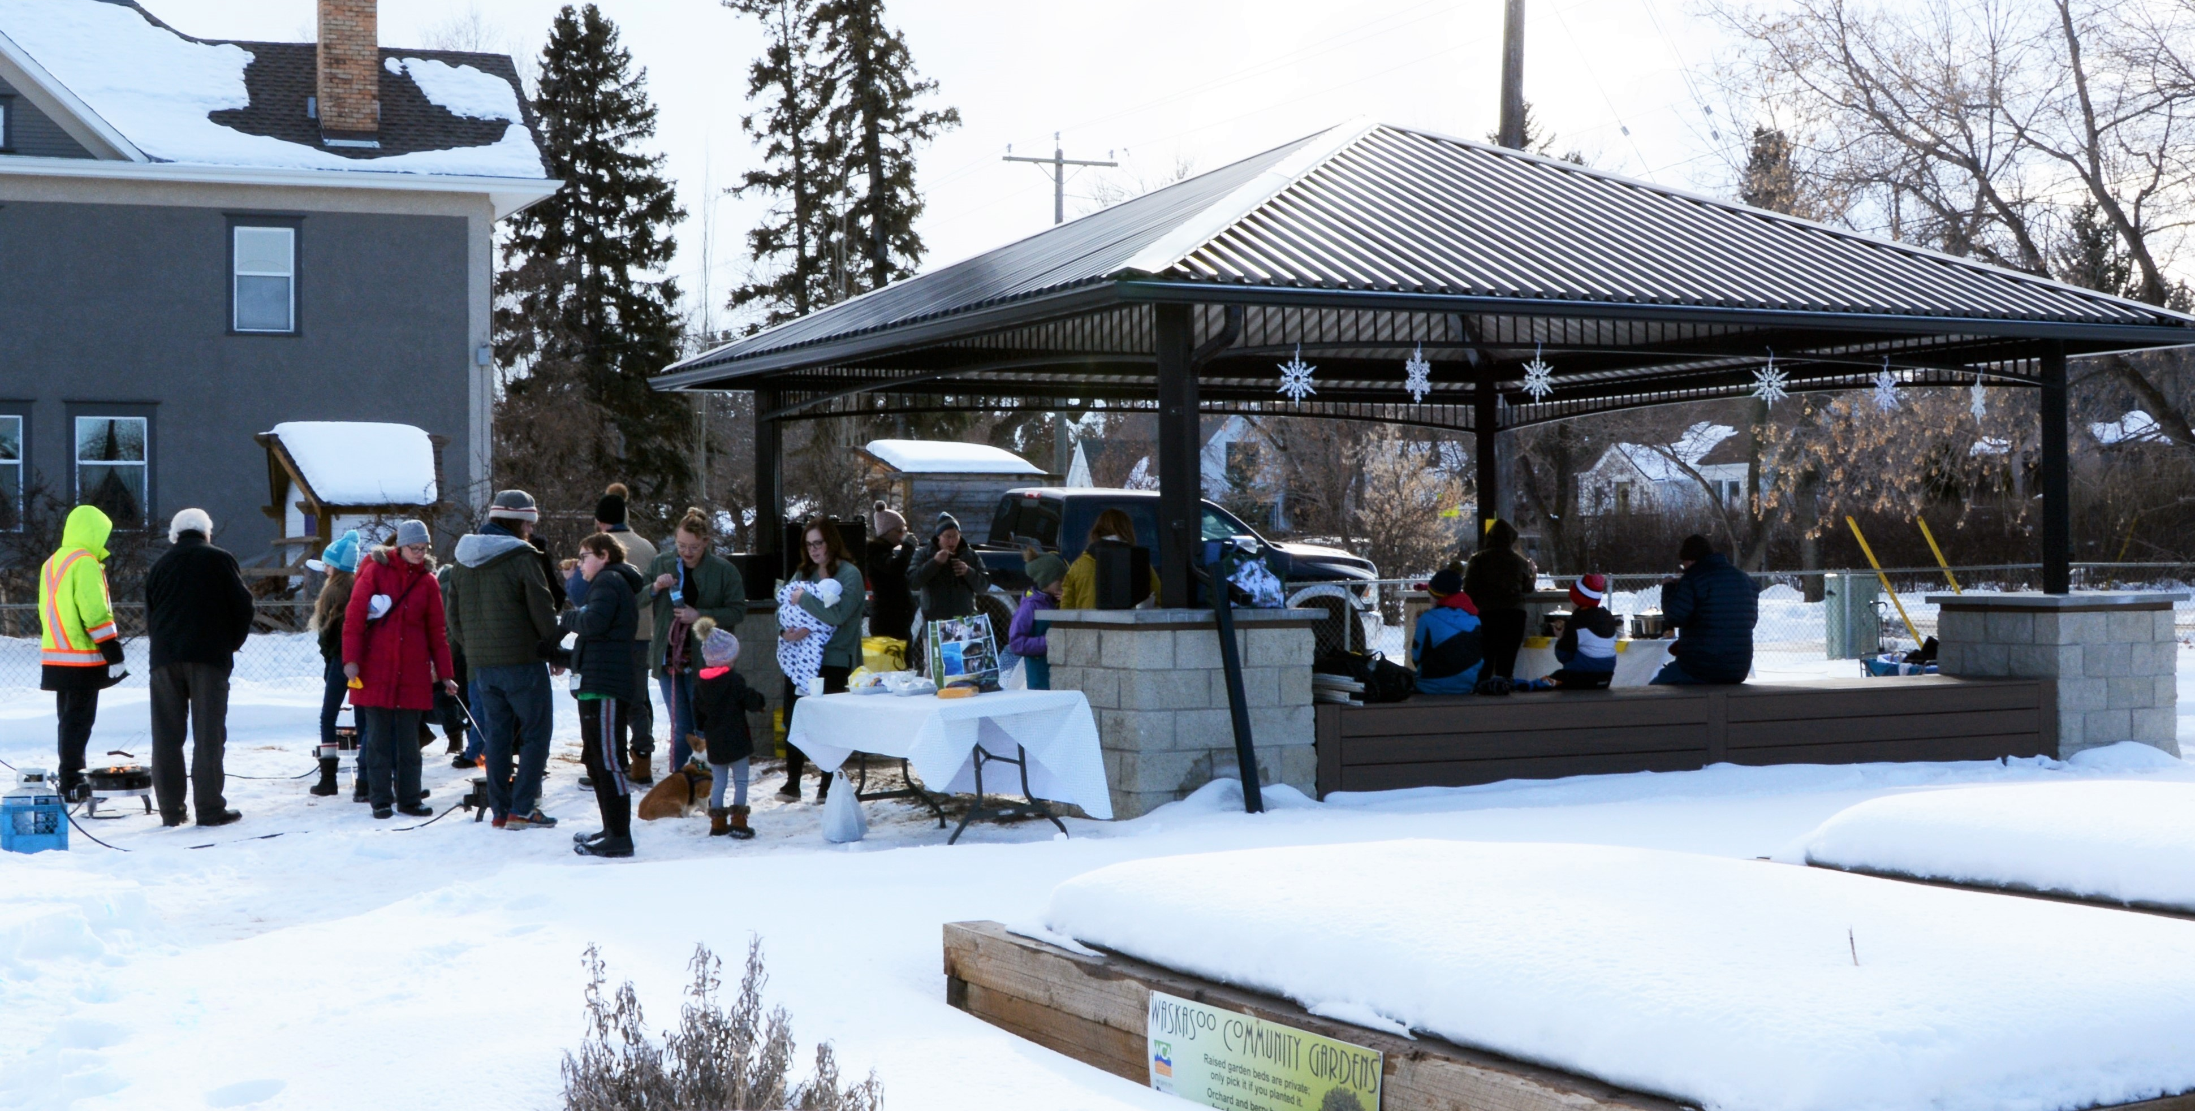
Total Income: $18,682.65
Expenses:
Bank charges 13.75
Winterfest Event 782.09
Winterfest refund to City 239.00
Garden Plots 50.19
Website Administration 20.17
Drive In movie night 1760.15
Director and Liability Insurance 650.00
AGM (2021 save-the-date mailer) 63.35
Total Expenses: $3578.70
CLOSING BALANCE, December 31, 2020 $15,103.95

Slide 20
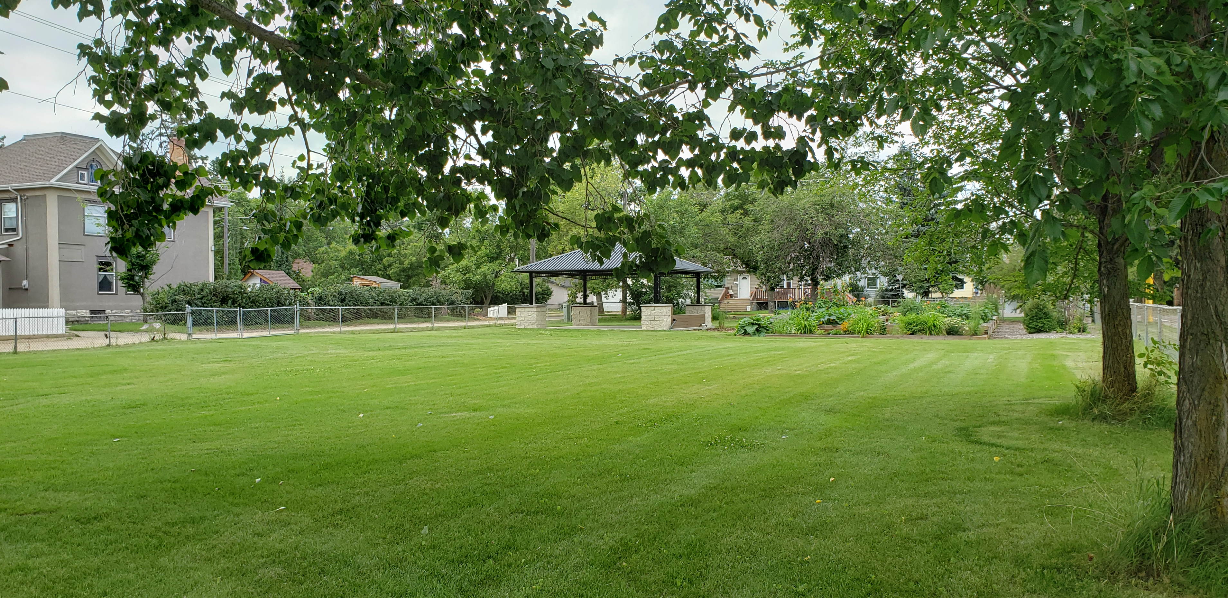
2021 OPERATING BUDGET
EXPENSES
Bank Charges $115
AGM $400
Green Deer $200
Membership Drive $200
Website $175
Miscellaneous $165
Insurance
Directors’ $650
Event $695
SPARK Events
BBQ $1000
Winter Festival $1000
Movie Night $1000
TOTAL EXPENSES $5600
INCOME
City of Red Deer Operating Grant $2000
Memberships $500
Community Gardens $100
SPARK Event Grants $3000
TOTAL INCOME: $5600

Slide 21
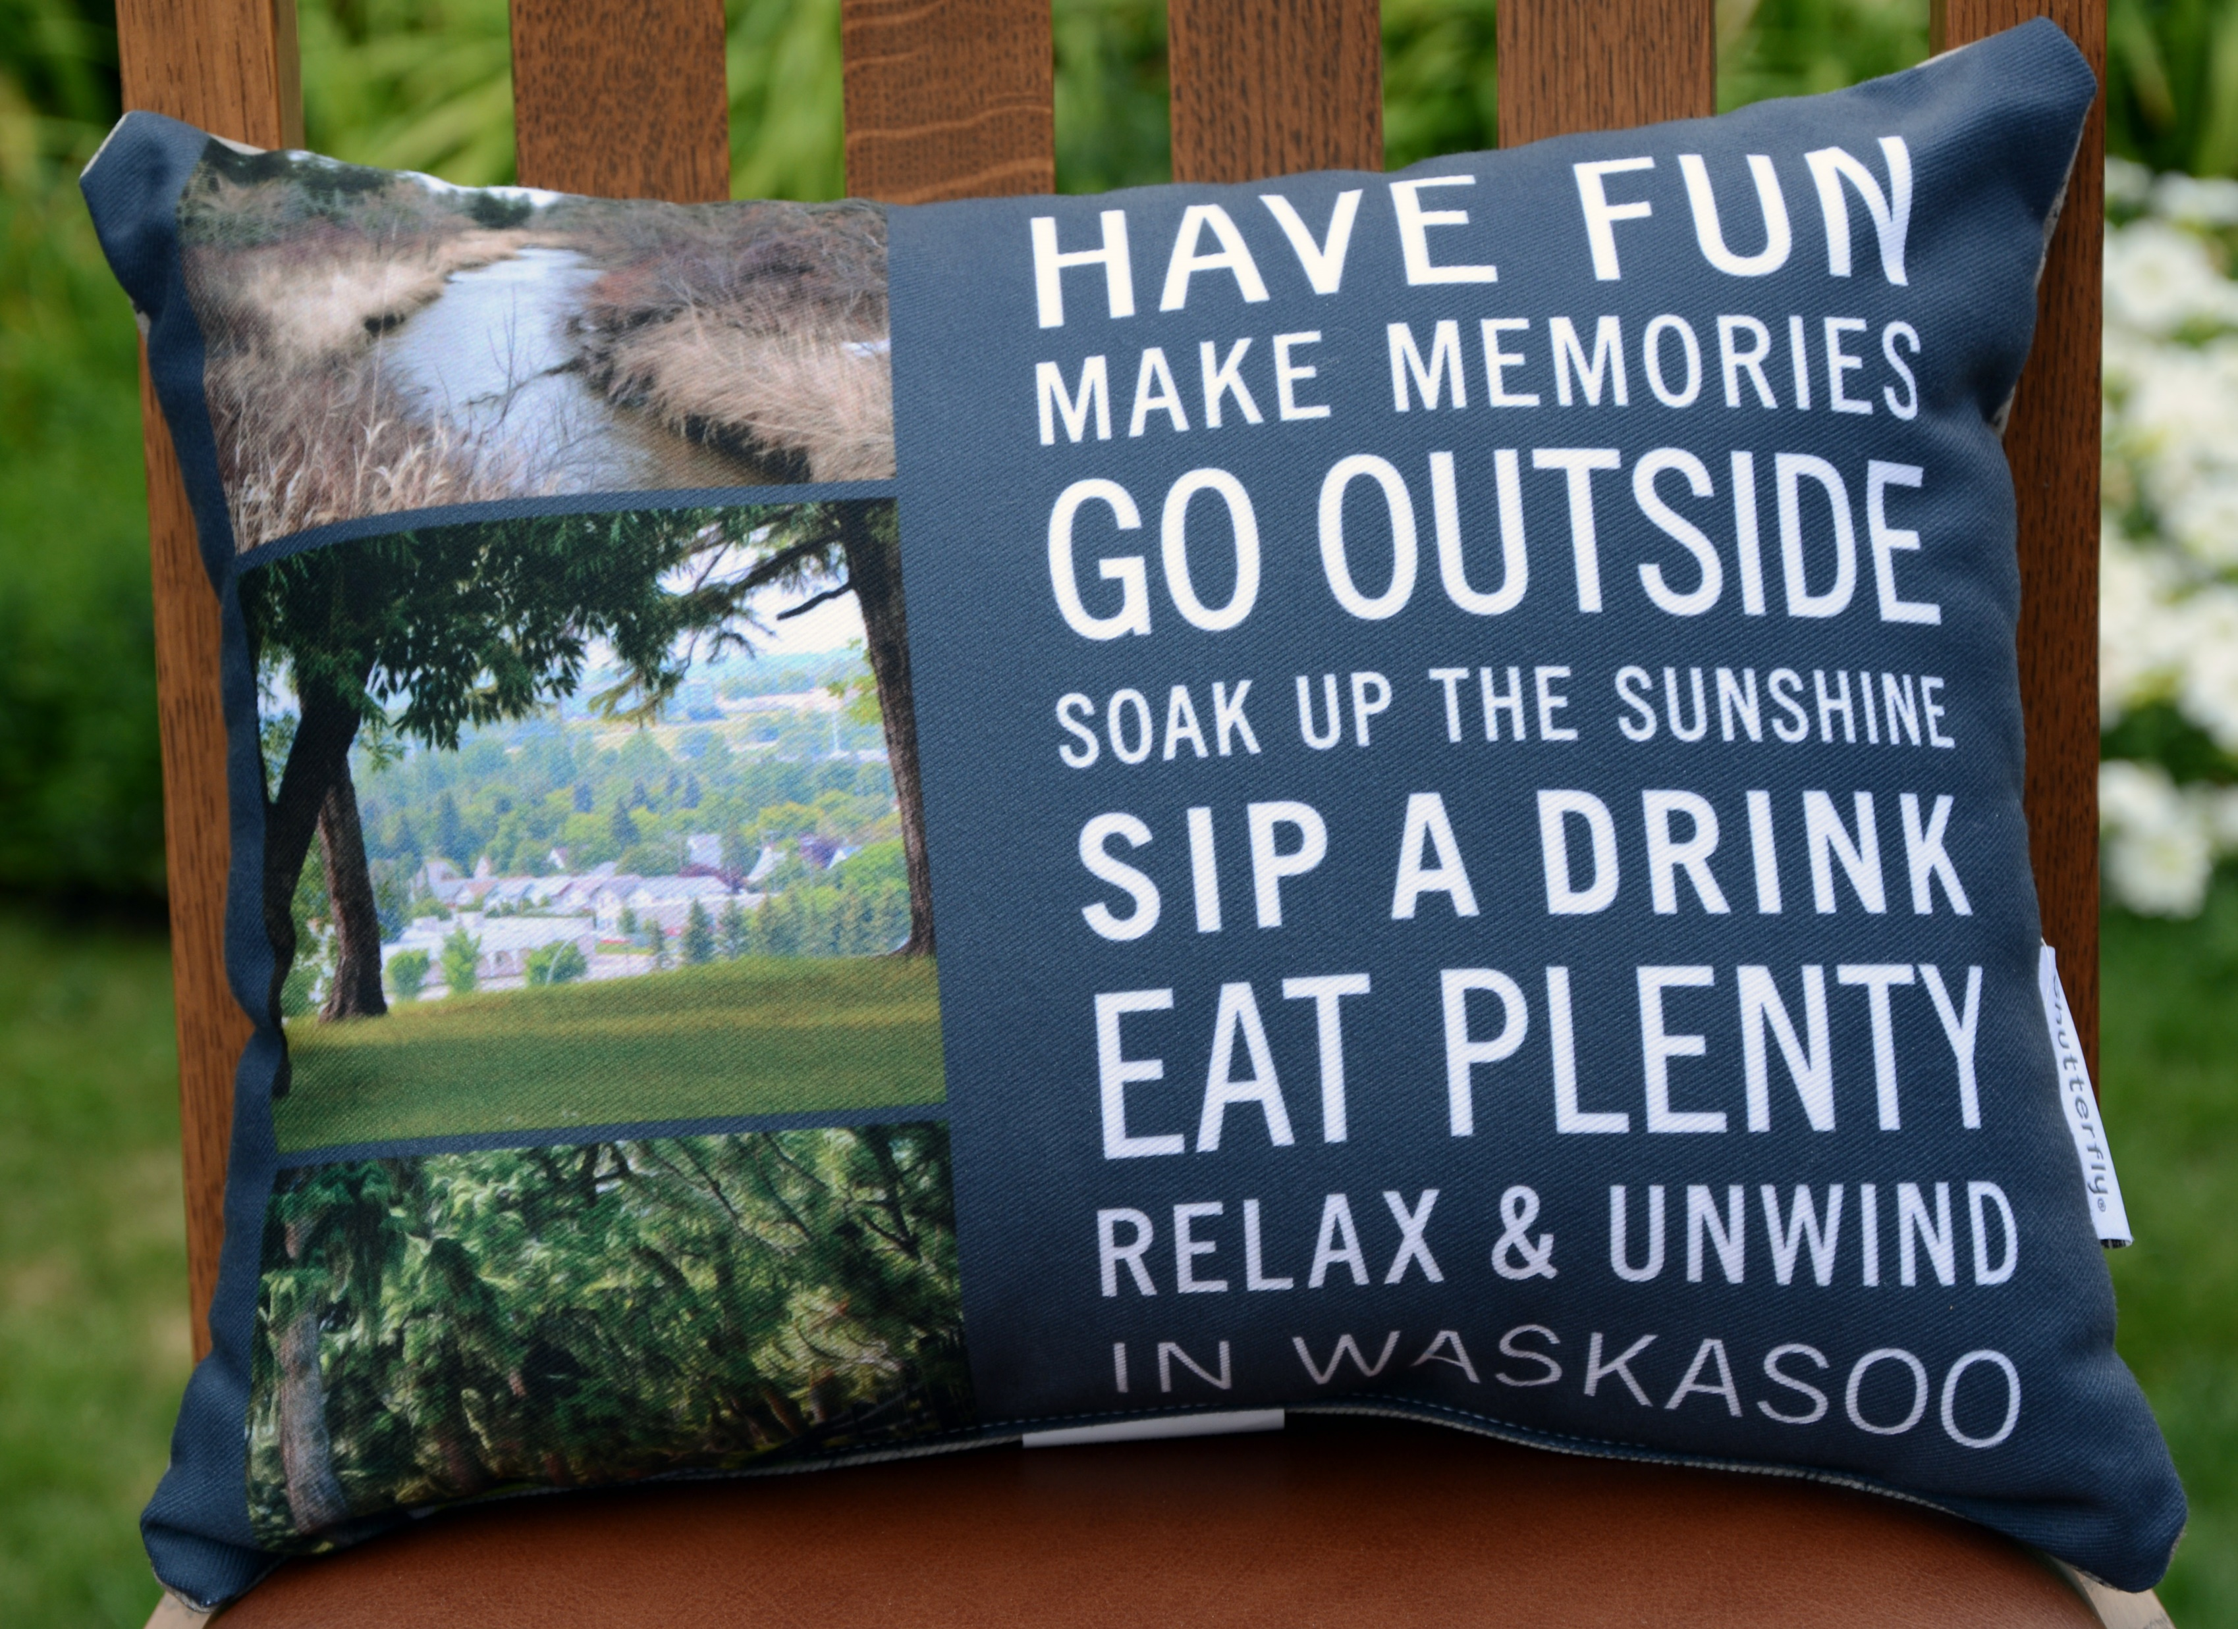
MOTION TO APPROVE THE TREASURER’S REPORT

Slide 22
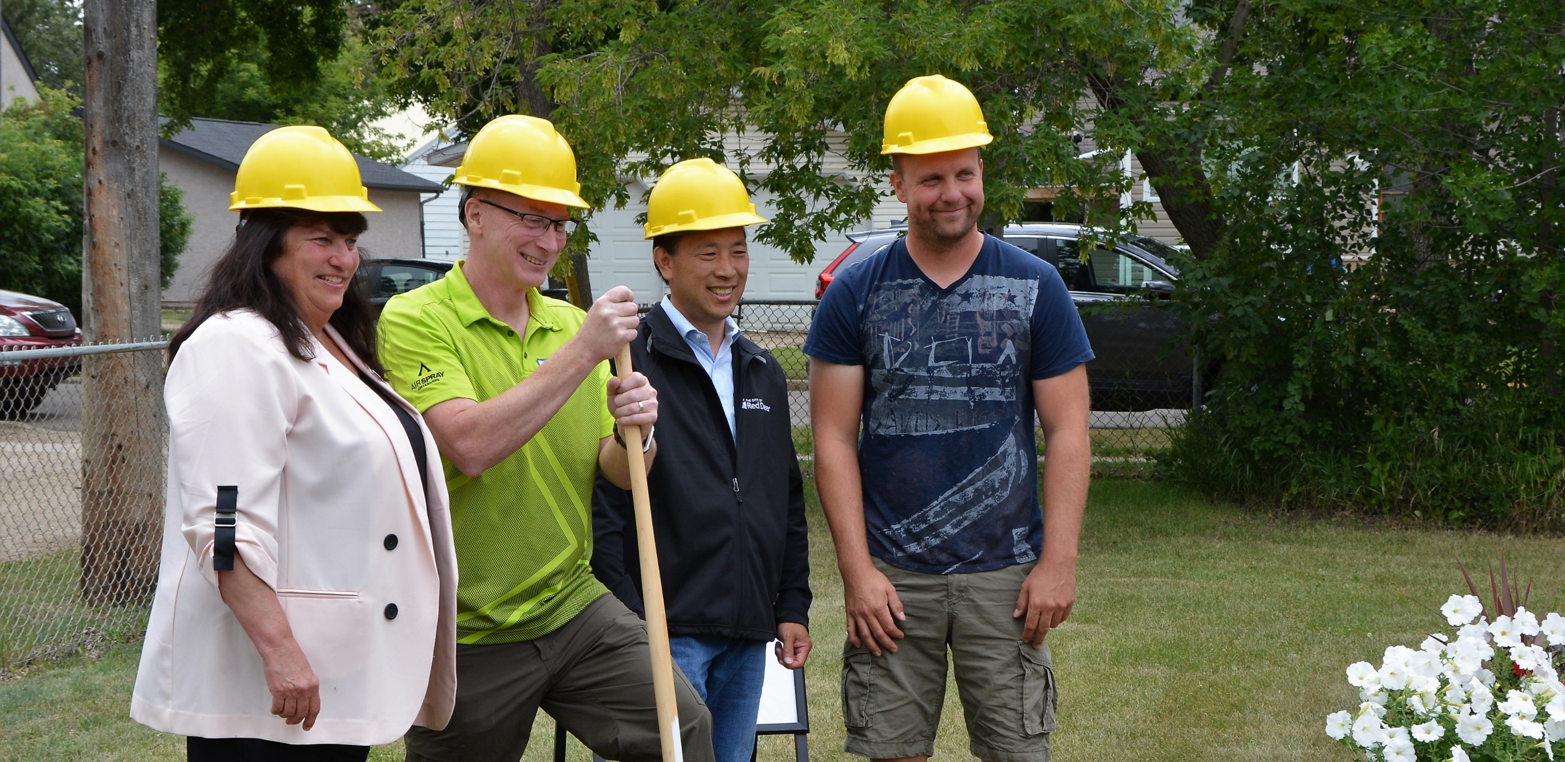
2021 BOARD ELECTIONS
Officers
Nominees for President:
Vote:
Nominees for Vice President:
Vote:
Nominees for Treasurer:
Vote:
Nominees for Secretary:
Vote:

Slide 23
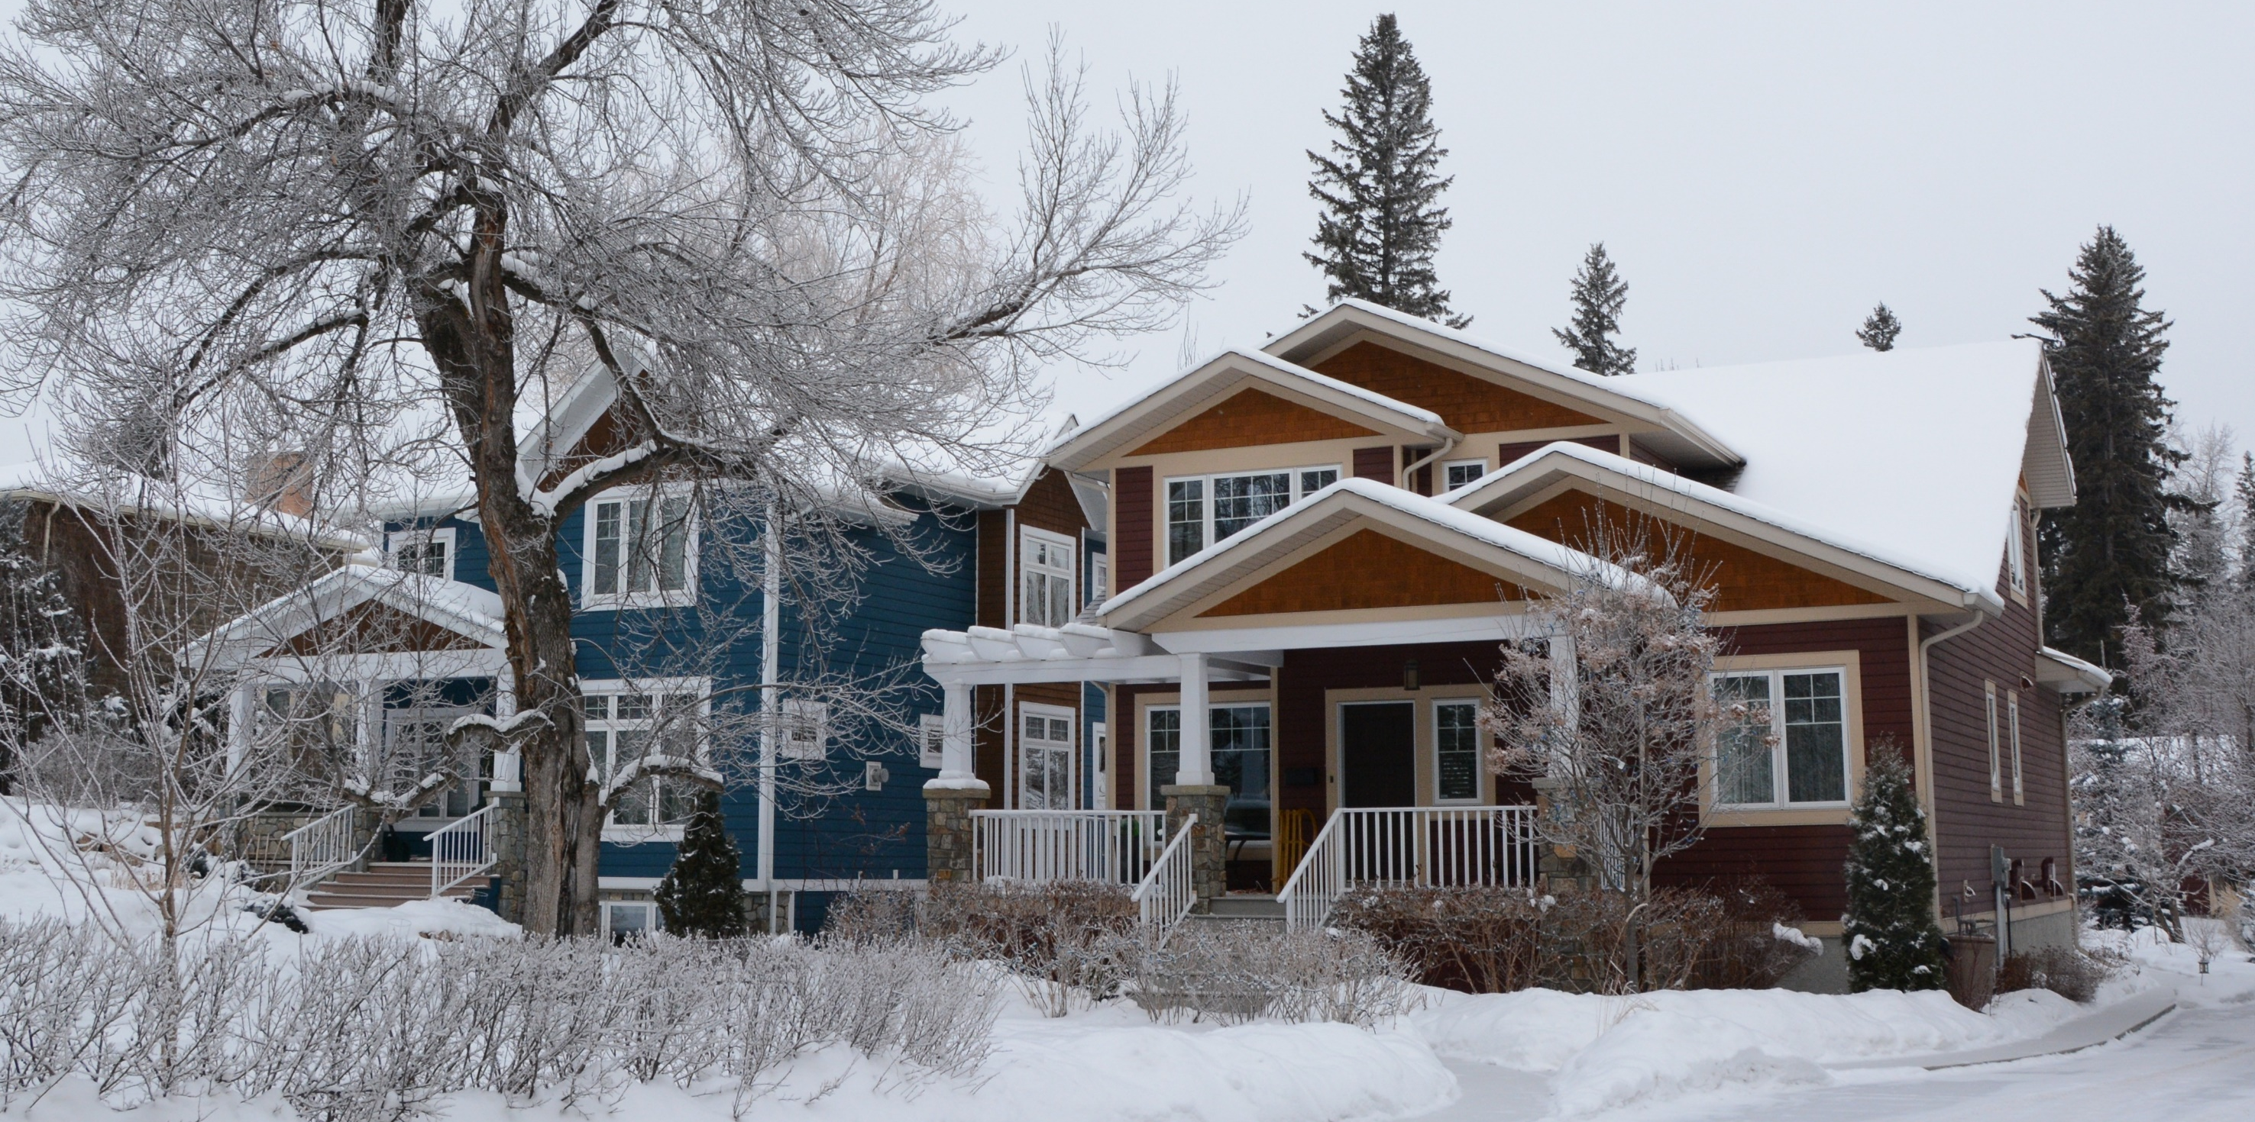
Directors
Current Directors Willing to Continue:
William Weiswasser
Susan Jensen
Kristen Steenbergen
Marianne Lee
Nick Schultz
Vote:
Nominees for New Directors:
Vote:

Slide 24
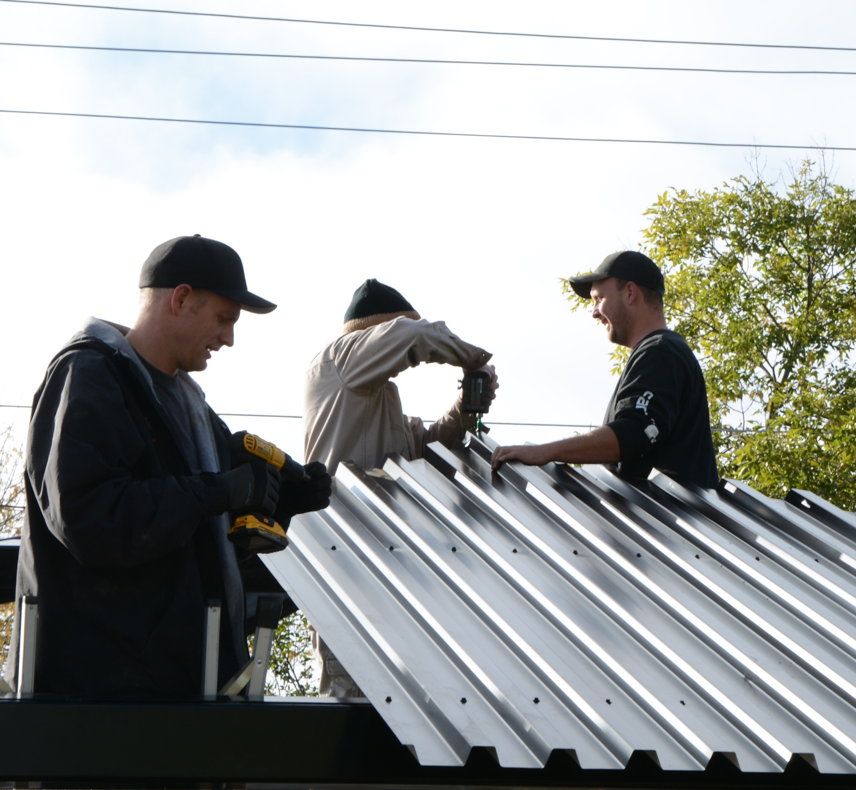
Honorary Lifetime Members: The Nolets

Slide 25
Discussion
Irv and Kathy Sandulak: Gateway School Traffic
Alandra and Garrett Aucoin: New Homeowners in West Waskasoo
Other Items?

